Slide 1
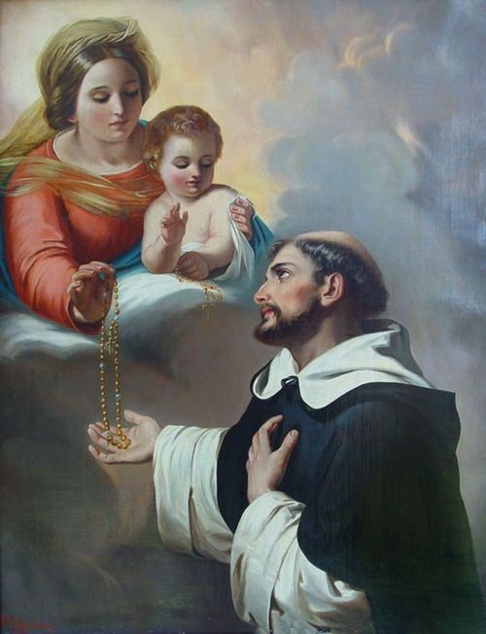
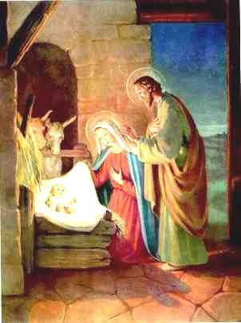
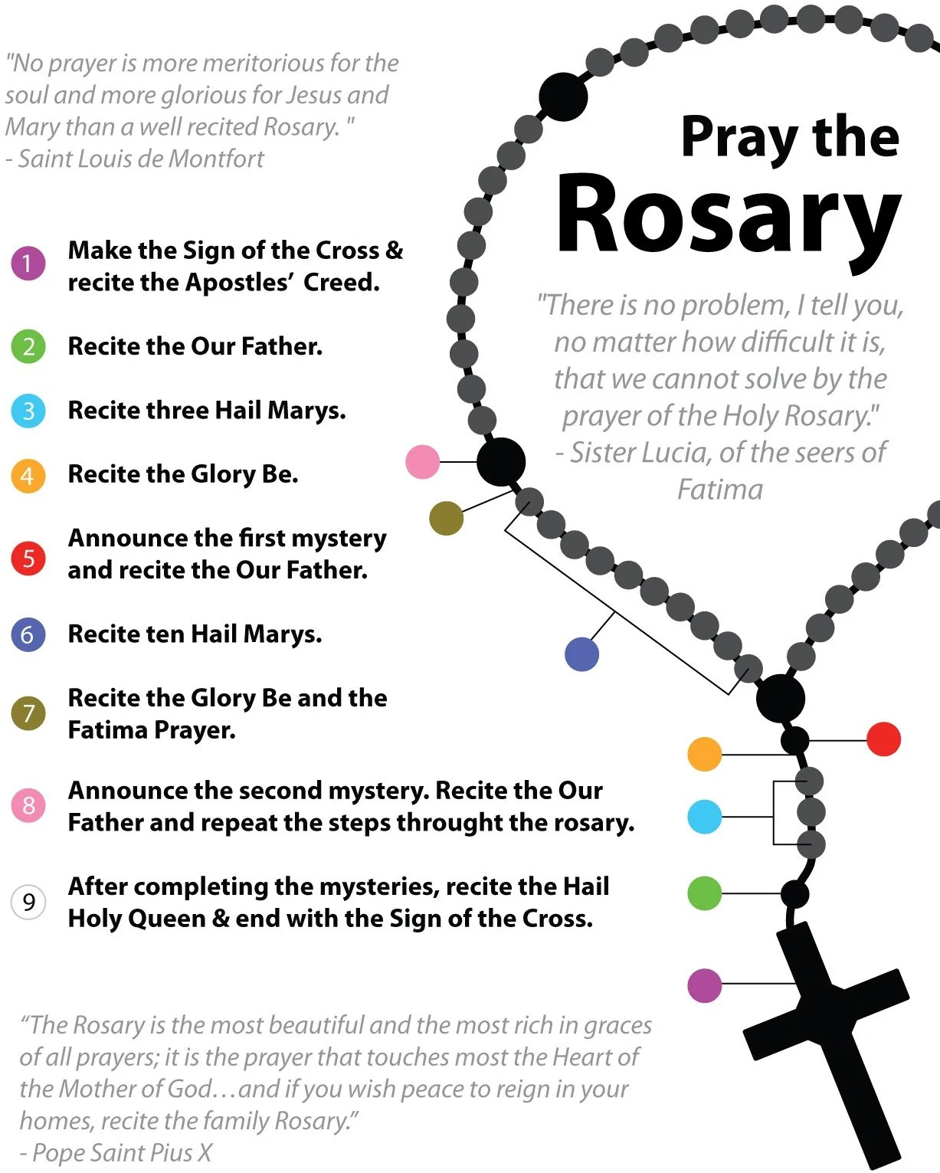
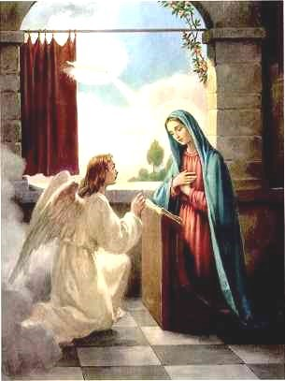
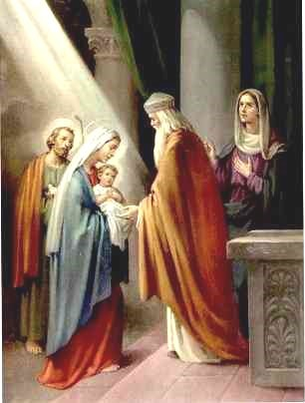
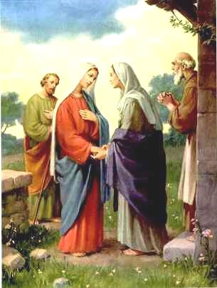
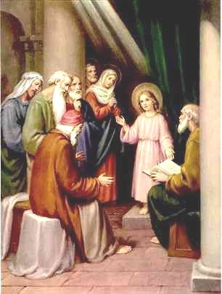
ROSARY MEDITATIONS
The Birth of Jesus
Caesar Augustus ordered a census of the Roman world, requiring everyone to travel to their ancestral hometown, causing Mary, Mother of Jesus, to have to travel to Joseph’s hometown while being pregnant. Though difficult she still protected Jesus, and traveled a long way. Not being able to find a place to stay she gave birth to Jesus in a stable. I imagine that Mary suffered a lot while giving birth yet understanding what God wanted her to do she did many sacrifices to give birth. I pray that God gives me the understanding of Mary.
written by 7B Students of All Saints Catholic School
in October of 2026
Joyful Mysteries
Monday and Saturday
The Annunciation
The Angel of the Lord came down to Mary from heaven. He said, “Be not afraid, the Lord is with you. You shall conceive a son and his name will be Jesus, the son of God.” I imagine that Mary would be really scared because there is an angel in front of her. I pray that I can have the courage like Mary to stand up and not be afraid. I also pray that we can have the wisdom that Mary has.
The Presentation of Jesus in the Temple
Joseph and Mary took Jesus to the Temple to present him to the Lord. The law of Moses said that every firstborn male should be consecrated to the Lord. Simeon knew that God’s word was fulfilled because he lived to see Jesus. Simeon told Mary and Joseph that Jesus will be a sign to Israel but that He will be opposed. He also told Mary that she will be pierced with a sword. I imagine that Simeon is joyful because he lived to see the Anointed One. I pray that this mystery reminds me to always trust in God’s plan.
The Visitation
Jesus is found in the Temple
Mary and Joseph would go to Jerusalem for the feast of Passover, and when Jesus was twelve years old, He had to go with them according to festival custom. After a few days, they would be returning, but Jesus had stayed in Jerusalem without his parents knowing. They realized Jesus wasn't with them so they had to go back and look for him. I imagine them being so worried that they had lost Jesus in Jerusalem and were scared that people would take him away. I pray to grow in understanding and to get closer with God with obedience.
Mary just heard that she was having a baby and her cousin was too so she went to visit her. I imagine Mary being so happy for her cousin because Elizabeth finally has a child. I pray that God will give me strength to say “Yes!” like Mary did. I pray to have strong faith like her that I could be as caring as Mary. The last thing I pray is that I could be loving for people, even though I am going through something too.

Slide 2
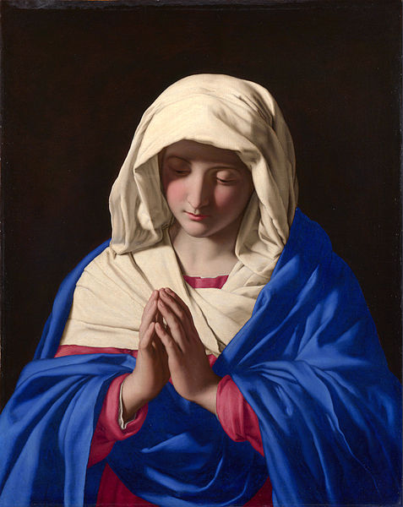
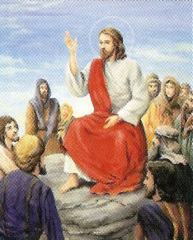
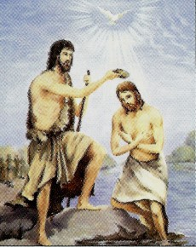
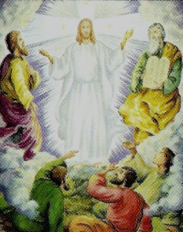
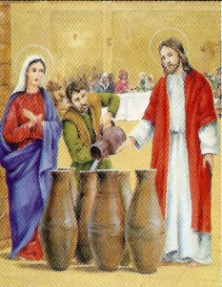
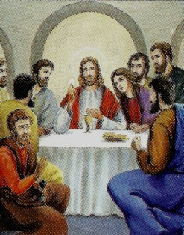
ROSARY MEDITATIONS
The Proclamation of the Kingdom
These are Jesus’s most famous teachings, the Sermon on the mount. Jesus travels through Galilee and teaches the good news of heaven . He performs miraculous healings and the curing of diseases . He teaches the beatitudes to the poor in spirit and to the meek , he promises the reward of Heaven . He also tells his followers that they should not hide their light but do better so others shine. I imagine that it would be exciting to see Jesus and to learn his teachings . I pray so I can grow in prudence and justice.
written by 7B Students of All Saints Catholic School
in October of 2025
Luminous Mysteries
Thursday
The Baptism of Jesus
It starts off with people going to get baptized by John in the Jordan River. After Jesus´s baptism, the sky opened up, and God spoke to him. I can imagine people thought John was Christ because of that. But he refused and led them to Jesus which was
the right path and said that he is just spreading Jesus’s word. I pray that God will guide me
to follow him just like John told the people to do.
The Transfiguration of Jesus
Jesus took Peter, James, and John his brother and led them up a high mountain. As they were walking they saw a light and were dazed by it. I imagine that the disciples were afraid and confused but Jesus had told them to not be afraid and look up for that He is the messiah. They look up, and see that there was a light that told them that Jesus was the messiah. I pray that I realize fully that God is my Messiah and to look up into the light and follow it, until it leads me to Heaven.
The Miracle at the Wedding of Cana
The Institution of the Holy Eucharist
It is the Passover meal in Jerusalem. Jesus and His apostles have all gathered in the upper room. When Judas betrays Jesus all are shocked that their close friend would do this. As the meal goes on Jesus institutes the Eucharist by saying “ this is my body, given up for you”. Later he says: “This is my blood given up for you”. I can imagine the shock of the apostles as they hear one of them will betray their savior. I pray for reverence during the sacrifice of the Eucharist.
At the wedding of Cana, Mary and Jesus were told that there wasn't any more wine. Mary told the waiter to let Jesus help them, and they did. Once he went into the room and everyone did just as Jesus asked. I imagine Jesus going into the room and performing the miracle while people watch him. Once there was enough wine for all of the people Jesus came back to Mary. I pray for Jesus' love for helping others around him.

Slide 3
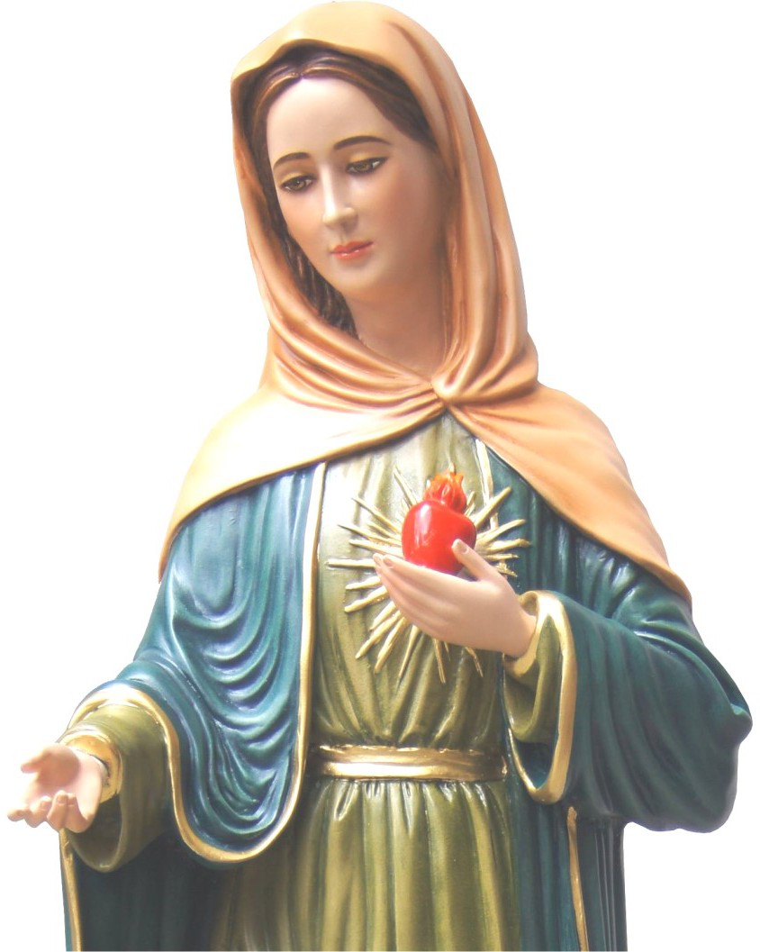
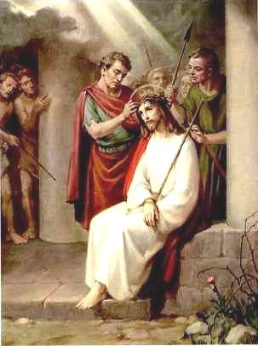
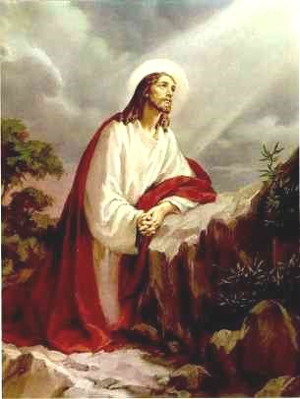
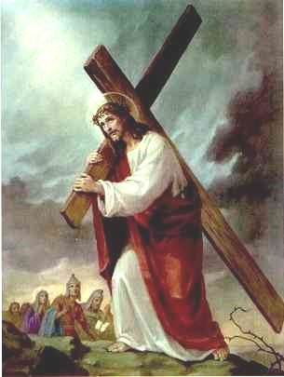
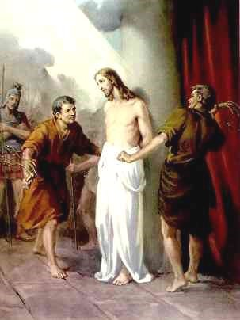
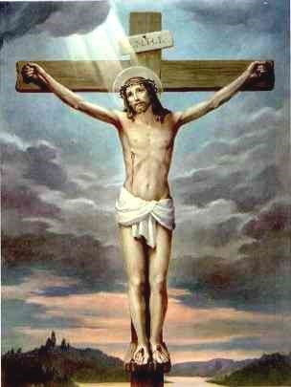
ROSARY MEDITATIONS
The Crowning of Thorns
The Roman soldiers placed a Crown of Thorns on Jesus' head, mocking him as king. I imagine the pain Jesus feels as the blood is dripping down his face and the soldiers are laughing at him. His patience reminds me of how hard it is to stay calm when others hurt our feelings. I pray for patience when I'm upset, for the strength to stand up for others when they're being treated unfairly. Also for a forgiving heart like Jesus' as he was never mad at the soldiers for doing what they did.
written by 7B Students of All Saints Catholic School
in October of 2025
Sorrowful Mysteries
Tuesday and Friday
The Agony in the Garden
Jesus knows that He will be betrayed. He knows that hours of anguish and miserable suffering lie in wait. He prays to His father, asking if there is another way. But He also yields His own desires to the will of the Father. I imagine the determination in His eyes as He thinks about His mission. Jesus’ bravery shows us that God has a purpose for everything. I pray that I can have the courage to do what is right even when I am scared.
Jesus Carrying His Cross
Jesus carried and died for our sins on the cross. He walked with the cross on his shoulders along with two other men. I imagine the women weeping for Jesus as they watch him carry the cross. Though Christ says to not weep for him but themselves. One of the men on the cross called "criminals" tell Jesus "remember me when you come into your kingdom" I pray Jesus knows me in heaven and I can be with him eternally in his kingdom.
The Scourging at the Pillar
The Crucifixion and Death of Jesus
They took Him to Golgotha and gave Jesus wine to drink but he did not accept it. They crucified and divided his garments and wrote above his head “King of the Jews.” On the ground people were saying He should come off the cross and He saved others but not himself. How I could imagine this is Jesus on the cross with people on the ground mocking him. I pray that I can get in a deeper relationship with Jesus and God.
They brought Jesus from Caiaphas to the praetorium. It was the morning. They themselves didn't go to the praetorium. I can picture Jesus being brave and calm even when there are people yelling “Crucify him”. I pray that God will help me grow in courage because courage can help during tests, homework or getting through class. Sometimes I don't have the courage to finish my homework in school but, I need to start building courage for that.

Slide 4
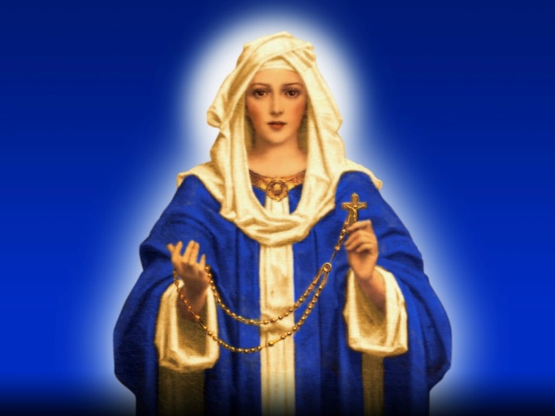
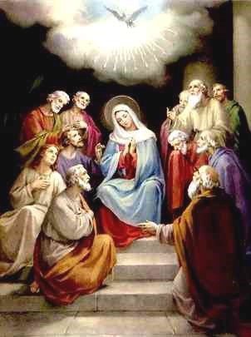
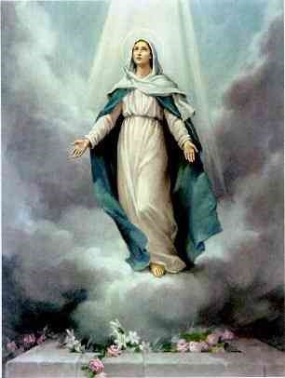
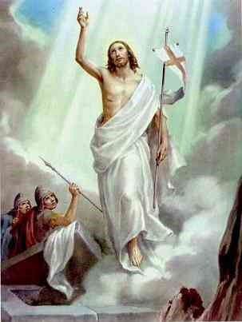
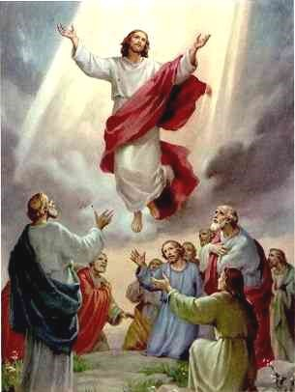
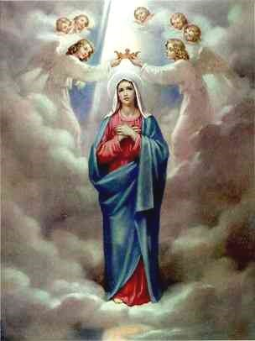
ROSARY MEDITATIONS
The Descent of the Holy Spirit at Pentecost
When the Holy Spirit came upon everyone as a fire on their heads, everyone spoke in their own tongue yet all who heard could hear in their own language. I imagine that there were thousands of people there and some of them spoke the same languages as others. I imagine all of them were feeling blessed at the time. I pray that I can have the gifts of the Holy Spirit in me.
written by 7B Students of All Saints Catholic School
in October of 2025
Glorious Mysteries
Sunday and Wednesday
The Resurrection of Jesus
Marie Magdala went to Jesus' tomb and saw that the tomb was open. I imagine that they were all scared because they thought that Jesus' tomb was open. They also are surprised because they don't know if someone took him. I pray that I can be as brave as Jesus when he was crucified. I hope that everyone in the world doesn't go to hell or purgatory and that the people in purgatory get out fast.
The Assumption of Mary into Heaven
The seventh angel blew his trumpet. Loud voices echoed saying “The kingdom of the world now belongs to our Lord and to his anointed, he will reign forever and ever” The elders who sat on thrones prostrated themselves and worshiped God. God's Temple was opened and the Ark could be seen. Flashes of lighting, earthquakes, and hailstorms were happening. I imagine hearing the trumpet and seeing flashes of lighting in the sky. I would probably feel amazed that everyone is worshiping God. I pray that God helps me trust him when things are confusing and helps me grow in faith
The Ascension of our Lord
The Coronation of Mary in Heaven
Mary is the Queen of Heaven and Earth and the mother of all of us. Satan wanted to kill the Son of God so that he could have power over the whole world. Satan came to Earth to destroy Mary, her child, and us all. I imagine Mary's emotions when she was visited by the angel Gabriel, and was told she would be the mother of Jesus. And after her Assumption she was crowned Queen of Heaven. I pray that we all model ourselves after Mary and Jesus in our everyday life.
Jesus is in the middle of the town when the people gather and ask him if He will restore the kingdom of Israel. Not aware they are all about to witness Him rise to heaven with the apostles . I imagine all the people confused but amazed at this sight. I see Jesus there glowing and floating away with the apostles as angels rising to heaven. All the people are staring at Jesus as he goes up and disappears. I pray that God will help me to understand all of his miracles and all He's done.

Slide 5
THE ROSARY
APOSTLES CREED
I believe in God,
the Father almighty,
Creator of heaven and earth,
and in Jesus Christ, his only Son, our Lord,
who was conceived by the Holy Spirit,
born of the Virgin Mary,
suffered under Pontius Pilate,
was crucified, died and was buried;
he descended into hell;
on the third day he rose again from the dead;
he ascended into heaven,
and is seated at the right hand of God the Father almighty;
from there he will come to judge the living and the dead.
I believe in the Holy Spirit,
the holy catholic Church,
the communion of saints,
the forgiveness of sins,
the resurrection of the body,
and life everlasting.
Amen.

Slide 6
THE ROSARY
OUR FATHER
Our Father, who art in heaven,
hallowed be thy name;
thy kingdom come;
thy will be done on earth as it is in heaven.
Give us this day our daily bread;
and forgive us our trespasses
as we forgive those who trespass
against us;
and lead us not into temptation,
but deliver us from evil.
Amen
HAIL MARY (x3)
Hail Mary, full of grace, the Lord is with you;
blessed are you among women,
and blessed is the fruit of your womb, Jesus.
Holy Mary, Mother of God,
pray for us sinners
now and at the hour of our death.
Amen.
GLORY BE
Glory be to the Father, the Son, and the Holy Spirit;
as it was in the beginning, is now, and ever shall be,
world without end.
Amen.

Slide 7
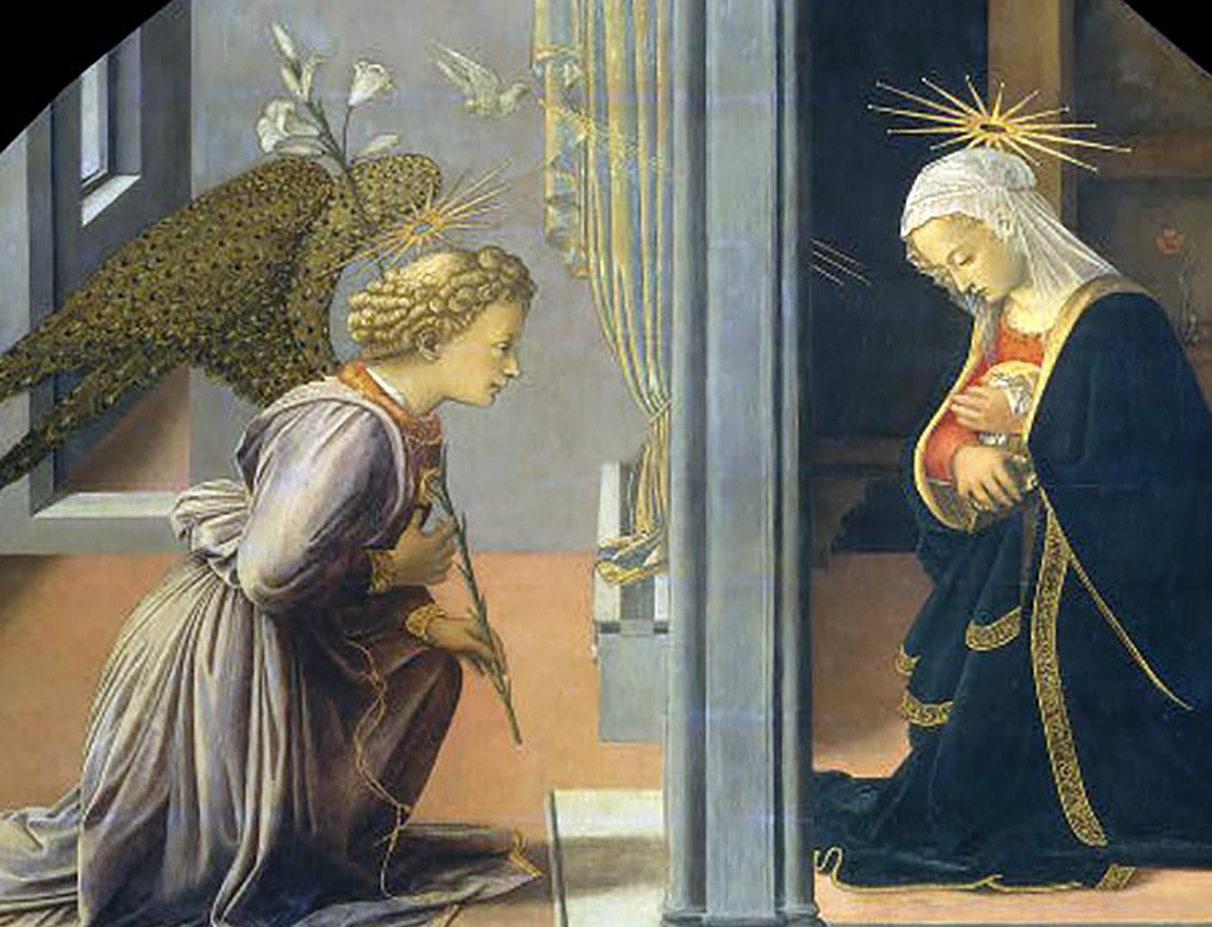
1st Joyful: ANNUNCIATION
The Angel of the Lord came down to Mary from heaven. He said, “Be not afraid, the Lord is with you. You shall conceive a son and his name will be Jesus, the son of God.” I imagine that Mary would be really scared because there is an angel in front of her. I pray that I can have the courage like Mary to stand up and not be afraid. I also pray that we can have the wisdom that Mary has.

Slide 8
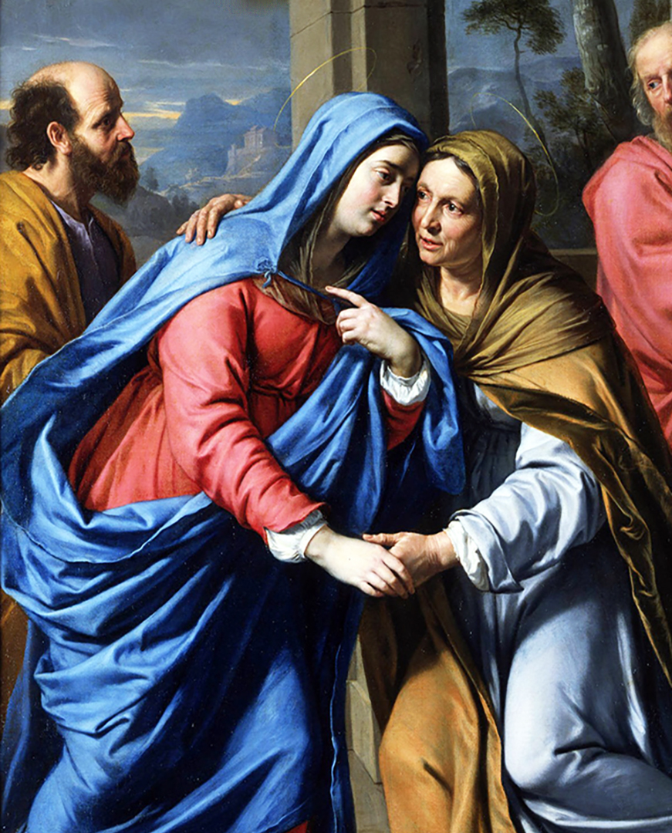
2nd Joyful: VISITATION
Mary just heard that she was having a baby and her cousin was too so she went to visit her. I imagine Mary being so happy for her cousin because Elizabeth finally has a child. I pray that God will give me strength to say “Yes!” like Mary did. I pray to have strong faith like her that I could be as caring as Mary. The last thing I pray is that I could be loving for people, even though I am going through something too.

Slide 9
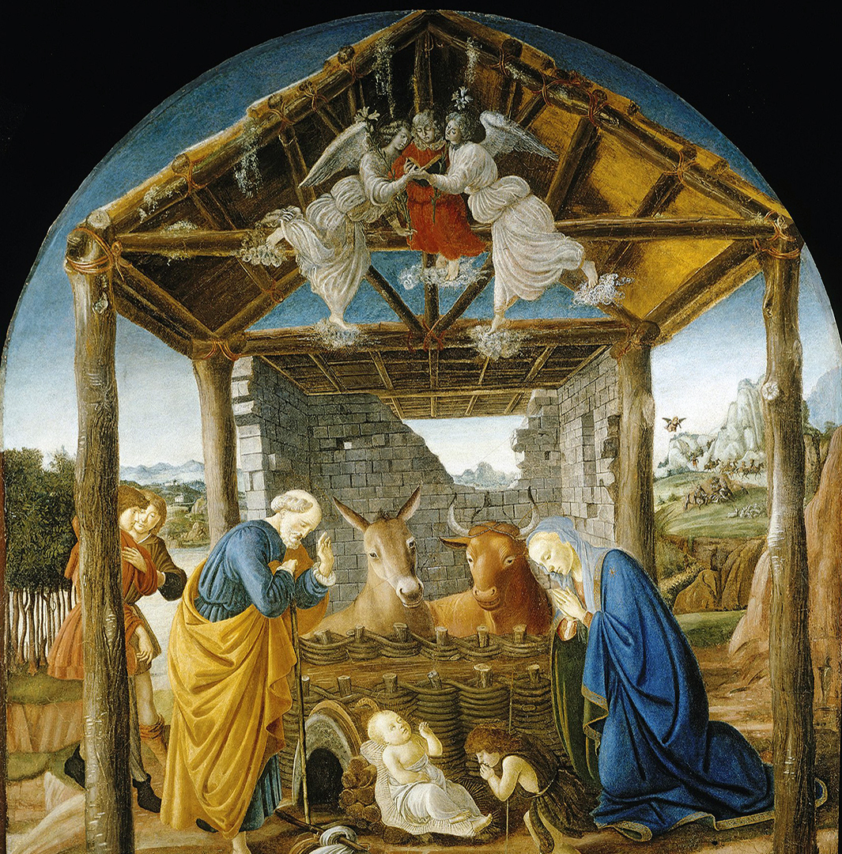
3rd Joyful: BIRTH OF JESUS
Caesar Augustus ordered a census of the Roman world, requiring everyone to travel to their ancestral hometown, causing Mary, Mother of Jesus, to have to travel to Joseph’s hometown while being pregnant. Though difficult she still protected Jesus, and traveled a long way. Not being able to find a place to stay she gave birth to Jesus in a stable. I imagine that Mary suffered a lot while giving birth yet understanding what God wanted her to do she did many sacrifices to give birth. I pray that God gives me the understanding of Mary.

Slide 10
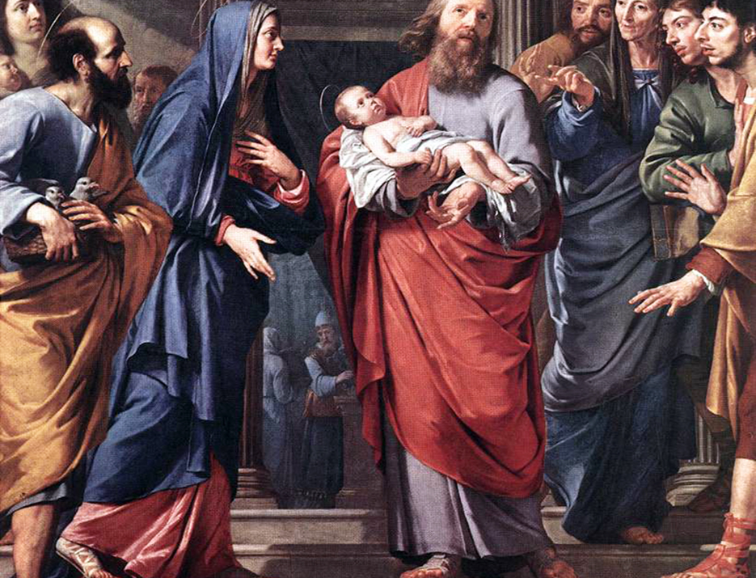
4th Joyful: PRESENTATION OF JESUS AT TEMPLE
Joseph and Mary took Jesus to the Temple to present him to the Lord. The law of Moses said that every firstborn male should be consecrated to the Lord. Simeon knew that God’s word was fulfilled because he lived to see Jesus. Simeon told Mary and Joseph that Jesus will be a sign to Israel but that He will be opposed. He also told Mary that she will be pierced with a sword. I imagine that Simeon is joyful because he lived to see the Anointed One. I pray that this mystery reminds me to always trust in God’s plan.

Slide 11
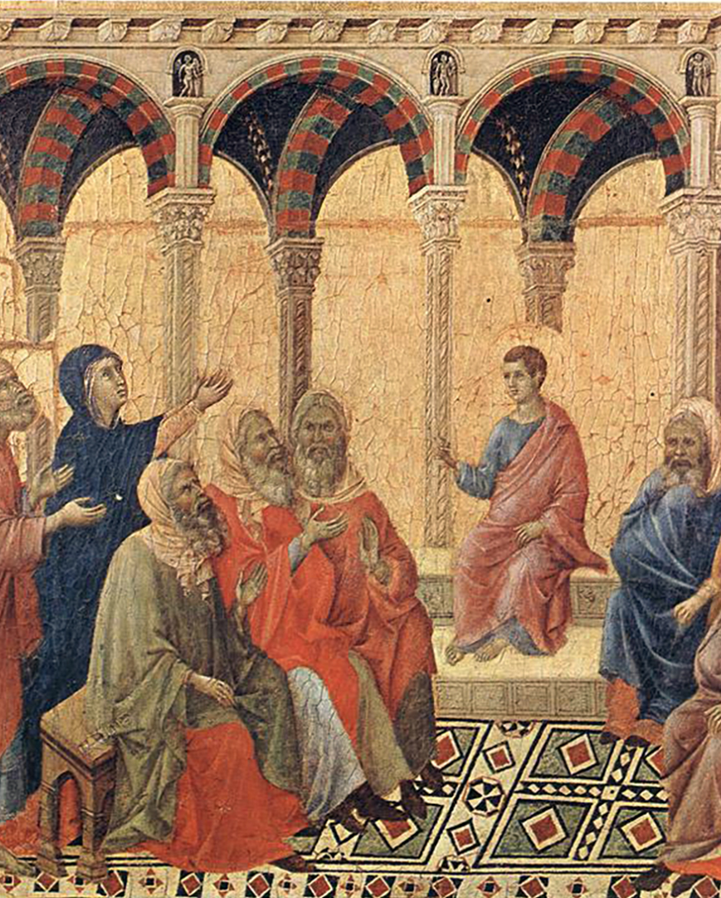
5th Joyful: JESUS IS FOUND IN THE TEMPLE
Mary and Joseph would go to Jerusalem for the feast of Passover, and when Jesus was twelve years old, He had to go with them according to festival custom. After a few days, they would be returning, but Jesus had stayed in Jerusalem without his parents knowing. They realized Jesus wasn't with them so they had to go back and look for him. I imagine them being so worried that they had lost Jesus in Jerusalem and were scared that people would take him away. I pray to grow in understanding and to get closer with God with obedience.

Slide 12
THE ROSARY
GLORY BE
Glory be to the Father, the Son, and the Holy Spirit;
as it was in the beginning, is now, and ever shall be,
world without end.
Amen.
FATIMA PRAYER
O my Jesus, forgive us our sins, save us from the fires of hell, and lead all souls to heaven, especially those most in need of Thy mercy.
OUR FATHER…

Slide 13
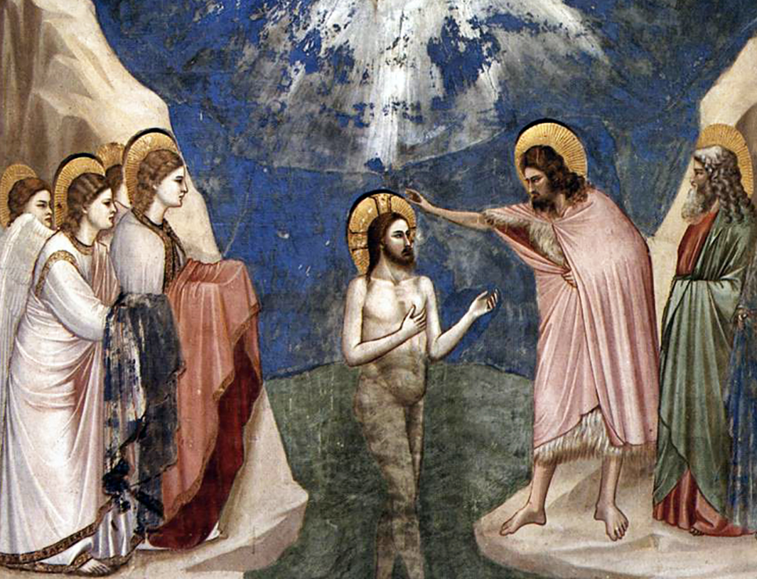
1st Luminous: BAPTISM OF JESUS
It starts off with people going to get baptized by John in the Jordan River. After Jesus´s baptism, the sky opened up, and God spoke to him. I can imagine people thought John was Christ because of that. But he refused and led them to Jesus which was the right path and said that he is just spreading Jesus’s word. I pray that God will guide me to follow him just like John told the people to do.

Slide 14
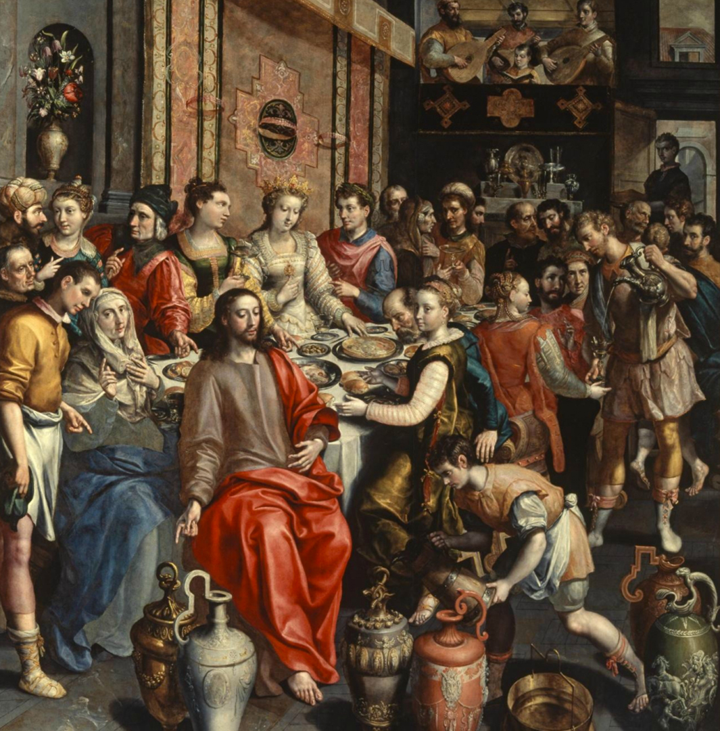
2nd Luminous: MIRACLE AT WEDDING OF CANA
At the wedding of Cana, Mary and Jesus were told that there wasn't any more wine. Mary told the waiter to let Jesus help them, and they did. Once he went into the room and everyone did just as Jesus asked. I imagine Jesus going into the room and performing the miracle while people watch him. Once there was enough wine for all of the people Jesus came back to Mary. I pray for Jesus' love for helping others around him.

Slide 15
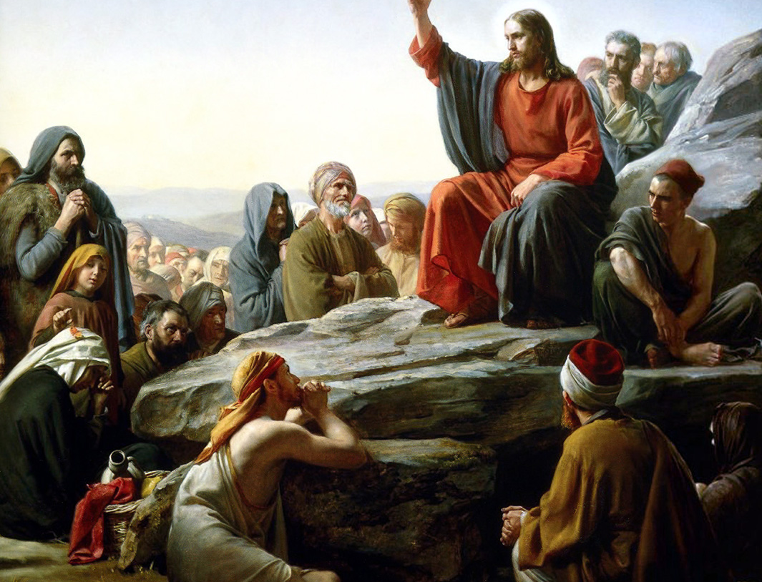
3rd Luminous: PROCLAMATION OF THE KINGDOM
These are Jesus’s most famous teachings, the Sermon on the mount. Jesus travels through Galilee and teaches the good news of heaven . He performs miraculous healings and the curing of diseases . He teaches the beatitudes to the poor in spirit and to the meek , he promises the reward of Heaven . He also tells his followers that they should not hide their light but do better so others shine. I imagine that it would be exciting to see Jesus and to learn his teachings . I pray so I can grow in prudence and justice.

Slide 16
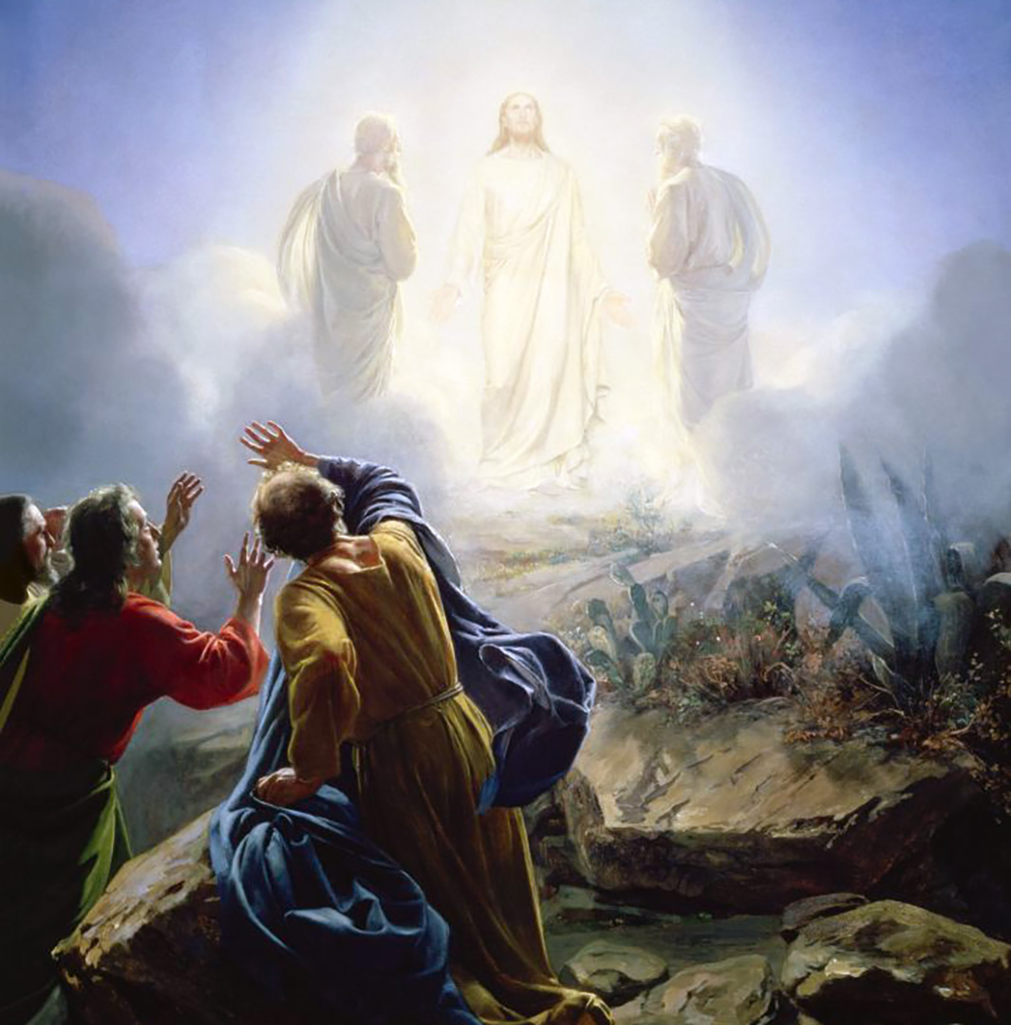
4th Luminous:
THE TRANSFIGURATION
Jesus took Peter, James, and John his brother and led them up a high mountain. As they were walking they saw a light and were dazed by it. I imagine that the disciples were afraid and confused but Jesus had told them to not be afraid and look up for that He is the messiah. They look up, and see that there was a light that told them that Jesus was the messiah. I pray that I realize fully that God is my Messiah and to look up into the light and follow it, until it leads me to Heaven.

Slide 17
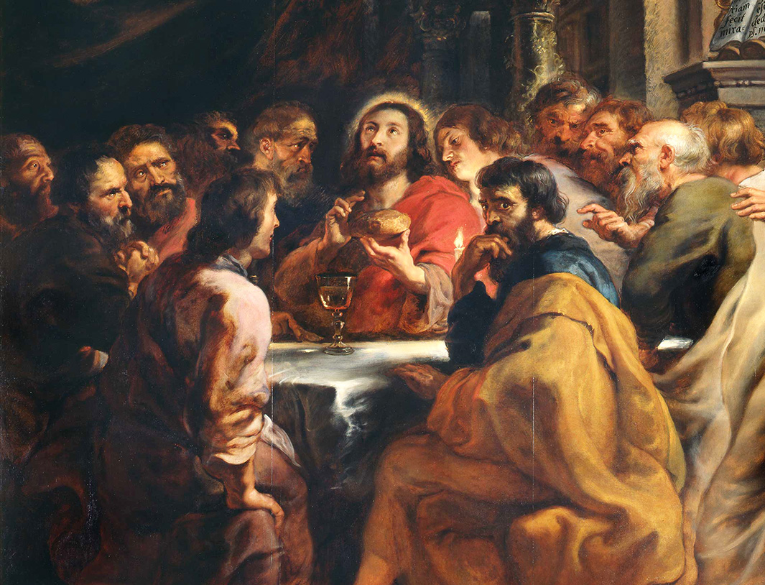
5th Luminous: INSTITUTION OF THE EUCHARIST
It is the Passover meal in Jerusalem. Jesus and His apostles have all gathered in the upper room. When Judas betrays Jesus all are shocked that their close friend would do this. As the meal goes on Jesus institutes the Eucharist by saying “ this is my body, given up for you”. Later he says: “This is my blood given up for you”.I can imagine the shock of the apostles as they hear one of them will betray their savior. I pray for reverence during the sacrifice of the Eucharist.

Slide 18
THE ROSARY
GLORY BE
Glory be to the Father, the Son, and the Holy Spirit;
as it was in the beginning, is now, and ever shall be,
world without end.
Amen.
FATIMA PRAYER
O my Jesus, forgive us our sins, save us from the fires of hell, and lead all souls to heaven, especially those most in need of Thy mercy.
OUR FATHER…

Slide 19
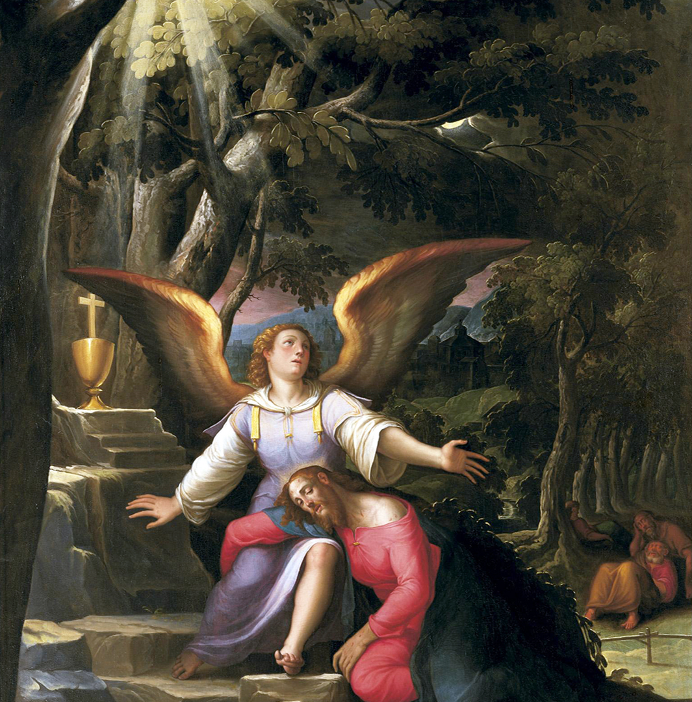
1st Sorrowful: AGONY IN
THE GARDEN
Jesus knows that He will be betrayed. He knows that hours of anguish and miserable suffering lie in wait. He prays to His father, asking if there is another way. But He also yields His own desires to the will of the Father. I imagine the determination in His eyes as He thinks about His mission. Jesus’ bravery shows us that God has a purpose for everything. I pray that I can have the courage to do what is right even when I am scared.

Slide 20
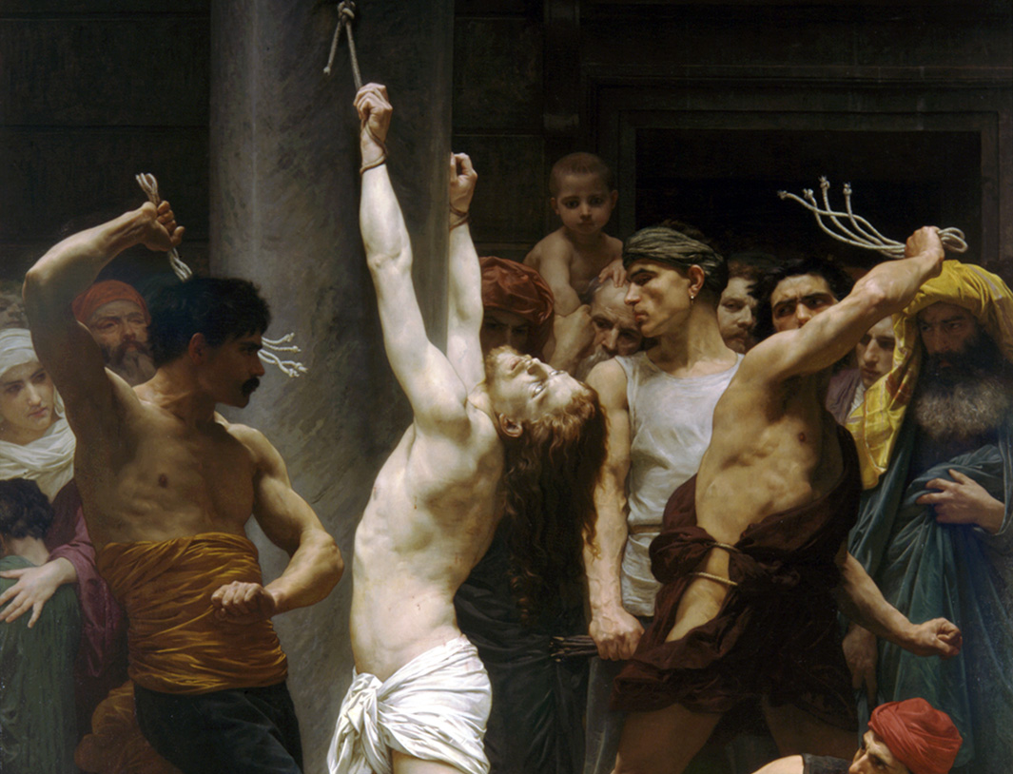
2nd Sorrowful: SCOURGING AT THE PILLAR
They brought Jesus from Caiaphas to the praetorium. It was the morning. They themselves didn't go to the praetorium. I can picture Jesus being brave and calm even when there are people yelling “Crucify him”. I pray that God will help me grow in courage because courage can help during tests, homework or getting through class. Sometimes I don't have the courage to finish my homework in school but, I need to start building courage for that.

Slide 21
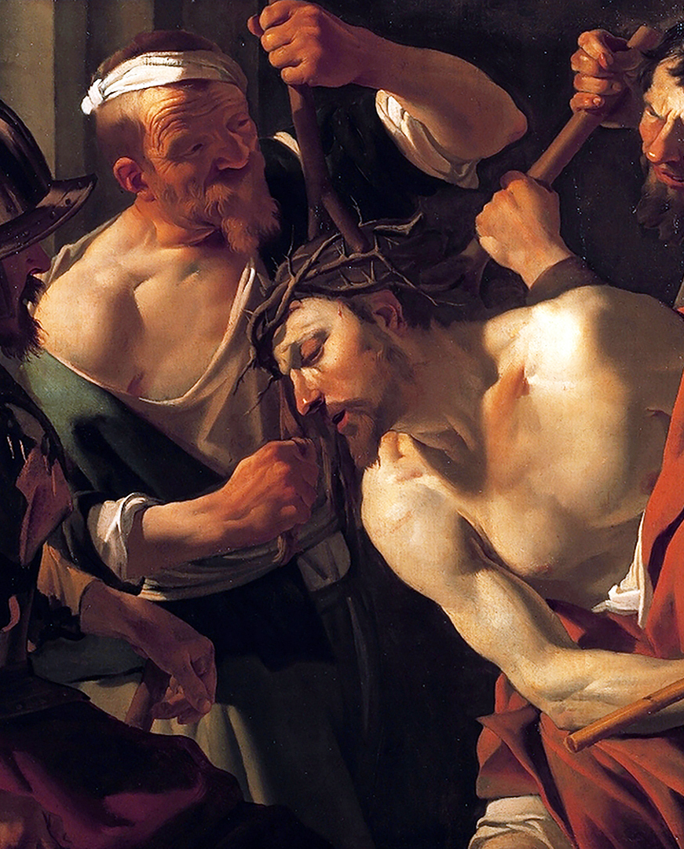
3rd Sorrowful: CROWNING OF THORNS
The Roman soldiers placed a Crown of Thorns on Jesus' head, mocking him as king. I imagine the pain Jesus feels as the blood is dripping down his face and the soldiers are laughing at him. His patience reminds me of how hard it is to stay calm when others hurt our feelings. I pray for patience when I'm upset, for the strength to stand up for others when they're being treated unfairly. Also for a forgiving heart like Jesus' as he was never mad at the soldiers for doing what they did.

Slide 22
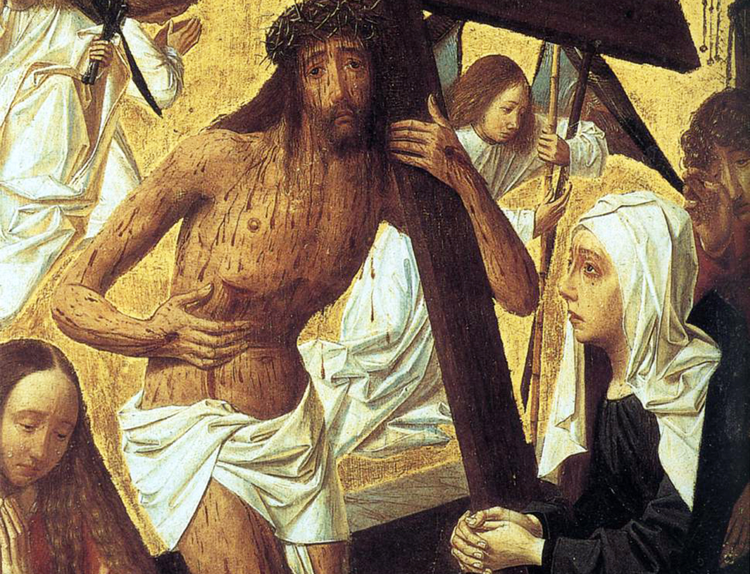
4th Sorrowful: JESUS CARRIES HIS CROSS
Jesus carried and died for our sins on the cross. He walked with the cross on his shoulders along with two other men. I imagine the women weeping for Jesus as they watch him carry the cross. Though Christ says to not weep for him but themselves. One of the men on the cross called "criminals" tell Jesus "remember me when you come into your kingdom" I pray Jesus knows me in heaven and I can be with him eternally in his kingdom.

Slide 23
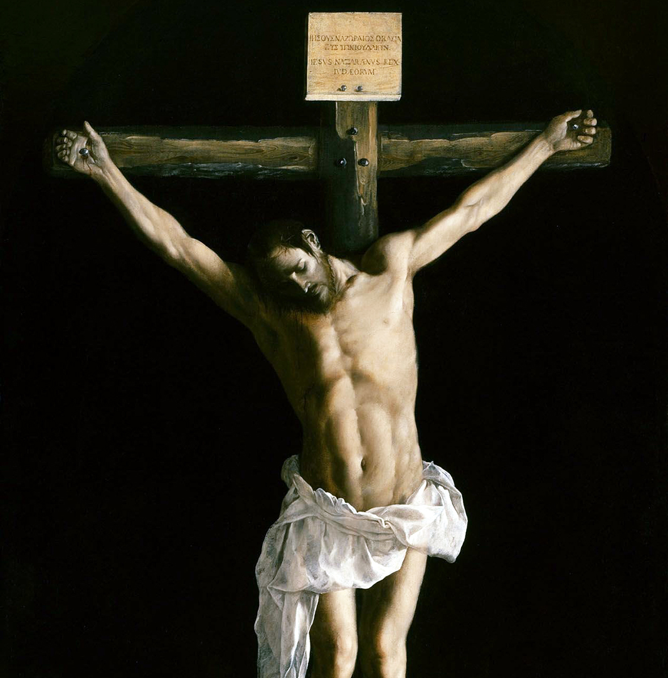
5th Sorrowful: CRUCIFIXION AND DEATH OF JESUS
They took Him to Golgotha and gave Jesus wine to drink but he did not accept it. They crucified and divided his garments and wrote above his head “King of the Jews.” On the ground people were saying He should come off the cross and He saved others but not himself. How I could imagine this is Jesus on the cross with people on the ground mocking him. I pray that I can get in a deeper relationship with Jesus and God.

Slide 24
THE ROSARY
GLORY BE
Glory be to the Father, the Son, and the Holy Spirit;
as it was in the beginning, is now, and ever shall be,
world without end.
Amen.
FATIMA PRAYER
O my Jesus, forgive us our sins, save us from the fires of hell, and lead all souls to heaven, especially those most in need of Thy mercy.
OUR FATHER…

Slide 25
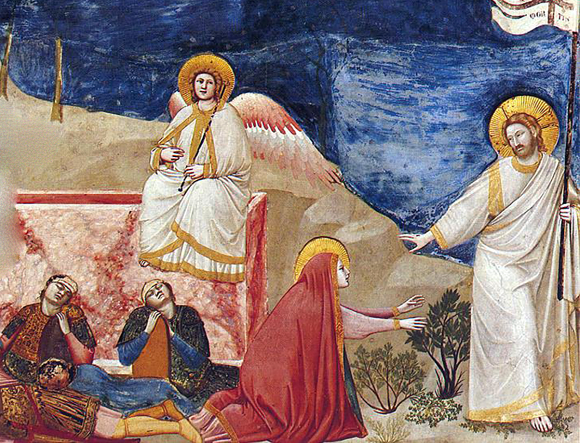
1st Glorious: RESURRECTION OF JESUS
Marie Magdala went to Jesus' tomb and saw that the tomb was open. I imagine that they were all scared because they thought that Jesus' tomb was open. They also are surprised because they don't know if someone took him. I pray that I can be as brave as Jesus when he was crucified. I hope that everyone in the world doesn't go to hell or purgatory and that the people in purgatory get out fast.

Slide 26
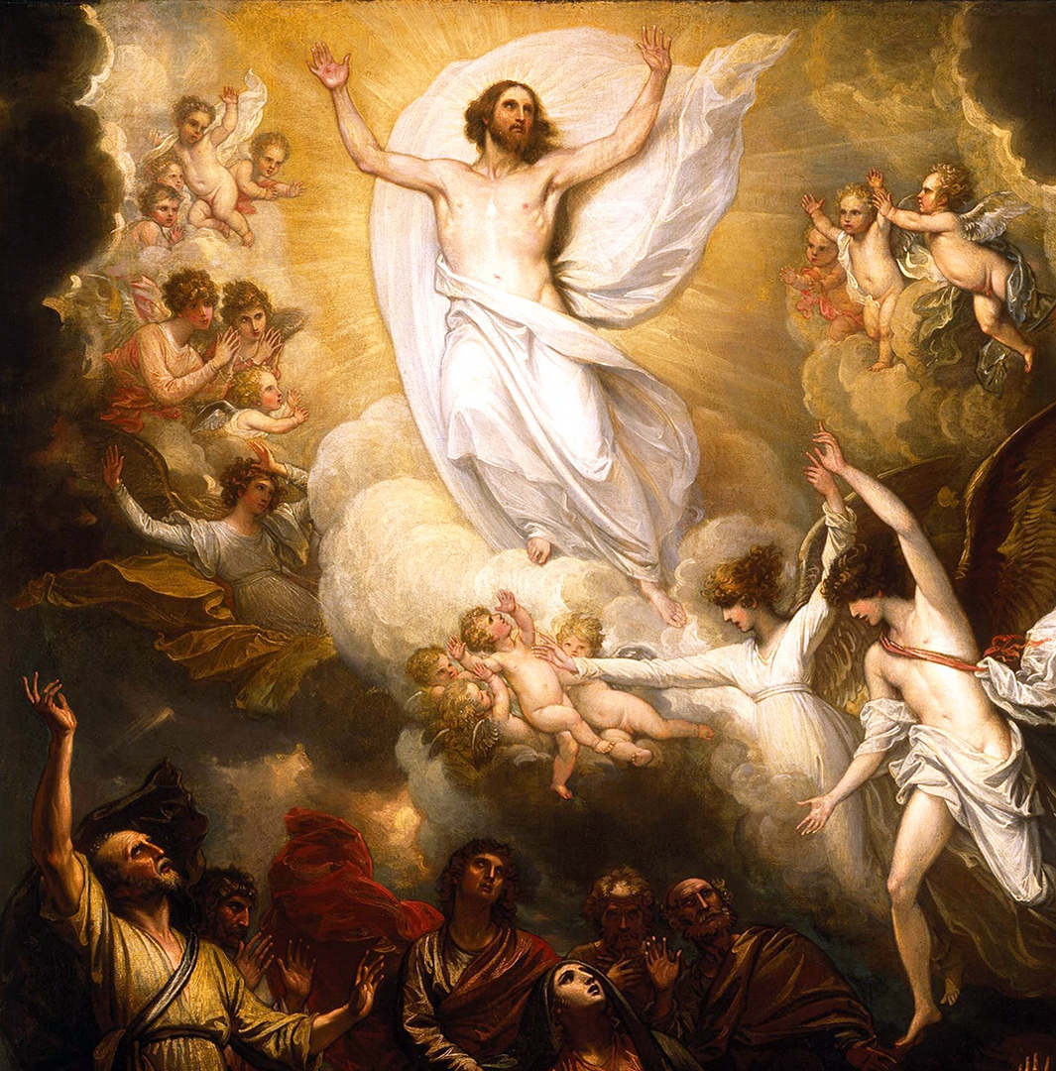
2nd Glorious: ASCENSION OF JESUS
Jesus is in the middle of the town when the people gather and ask him if He will restore the kingdom of Israel. Not aware they are all about to witness Him rise to heaven with the apostles . I imagine all the people confused but amazed at this sight. I see Jesus there glowing and floating away with the apostles as angels rising to heaven. All the people are staring at Jesus as he goes up and disappears. I pray that God will help me to understand all of his miracles and all He's done.

Slide 27
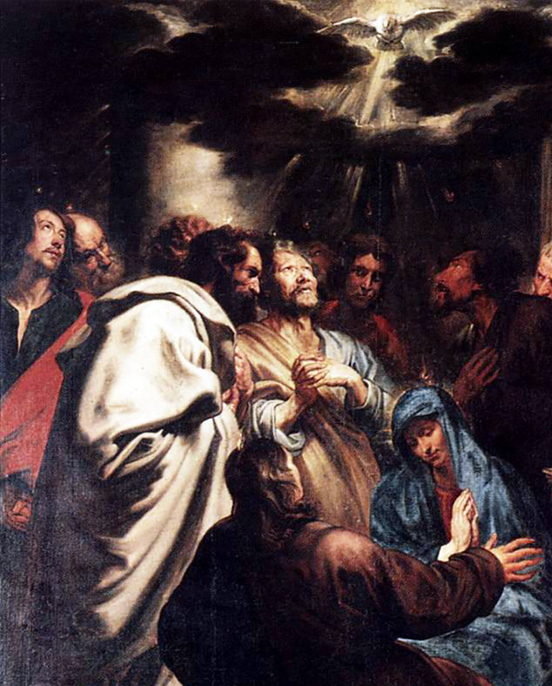
3rd Glorious: DESCENT OF THE HOLY SPIRIT
When the Holy Spirit came upon everyone as a fire on their heads, everyone spoke in their own tongue yet all who heard could hear in their own language. I imagine that there were thousands of people there and some of them spoke the same languages as others. I imagine all of them were feeling blessed at the time. I pray that I can have the gifts of the Holy Spirit in me.

Slide 28
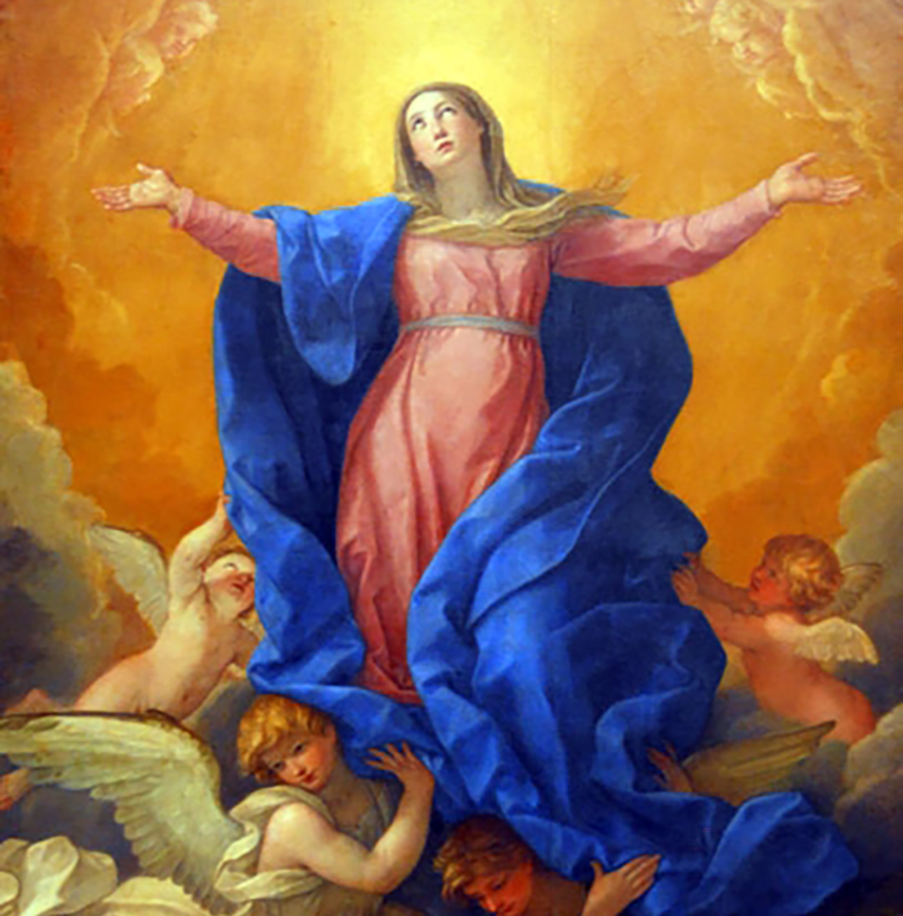
4th Glorious: ASSUMPTION OF MARY
The seventh angel blew his trumpet. Loud voices echoed saying “The kingdom of the world now belongs to our Lord and to his anointed, he will reign forever and ever” The elders who sat on thrones prostrated themselves and worshiped God. God's Temple was opened and the Ark could be seen. Flashes of lighting, earthquakes, and hailstorms were happening. I imagine hearing the trumpet and seeing flashes of lighting in the sky. I would probably feel amazed that everyone is worshiping God. I pray that God helps me trust him when things are confusing and helps me grow in faith

Slide 29
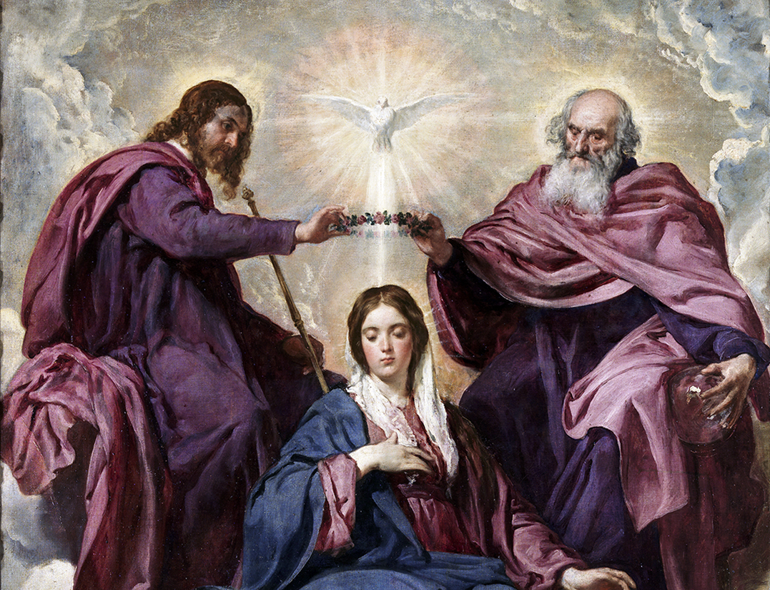
5th Glorious: CORONATION OF MARY
Mary is the Queen of Heaven and Earth and the mother of all of us. Satan wanted to kill the Son of God so that he could have power over the whole world. Satan came to Earth to destroy Mary, her child, and us all. I imagine Mary's emotions when she was visited by the angel Gabriel, and was told she would be the mother of Jesus. And after her Assumption she was crowned Queen of Heaven. I pray that we all model ourselves after Mary and Jesus in our everyday life.

Slide 30
THE ROSARY
GLORY BE
Glory be to the Father, the Son, and the Holy Spirit;
as it was in the beginning, is now, and ever shall be,
world without end.
Amen.
FATIMA PRAYER
O my Jesus, forgive us our sins, save us from the fires of hell, and lead all souls to heaven, especially those most in need of Thy mercy.

Slide 31
THE ROSARY
HAIL HOLY QUEEN
Hail, holy Queen, mother of mercy,
our life, our sweetness, and our hope.
To you we cry, poor banished children of Eve;
to you we send up our sighs,
mourning and weeping in this valley of tears.
Turn, then, most gracious advocate,
your eyes of mercy toward us;
and after this, our exile,
show unto us the blessed fruit of your womb, Jesus.
O clement, O loving, O sweet Virgin Mary.

