Slide 1
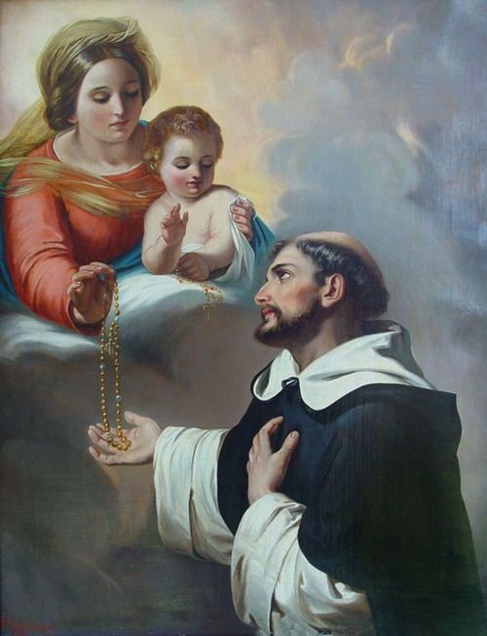
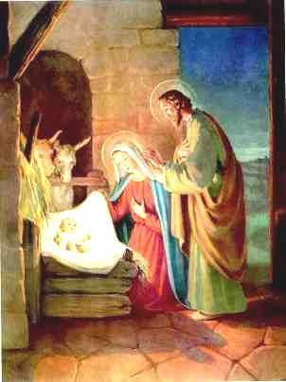
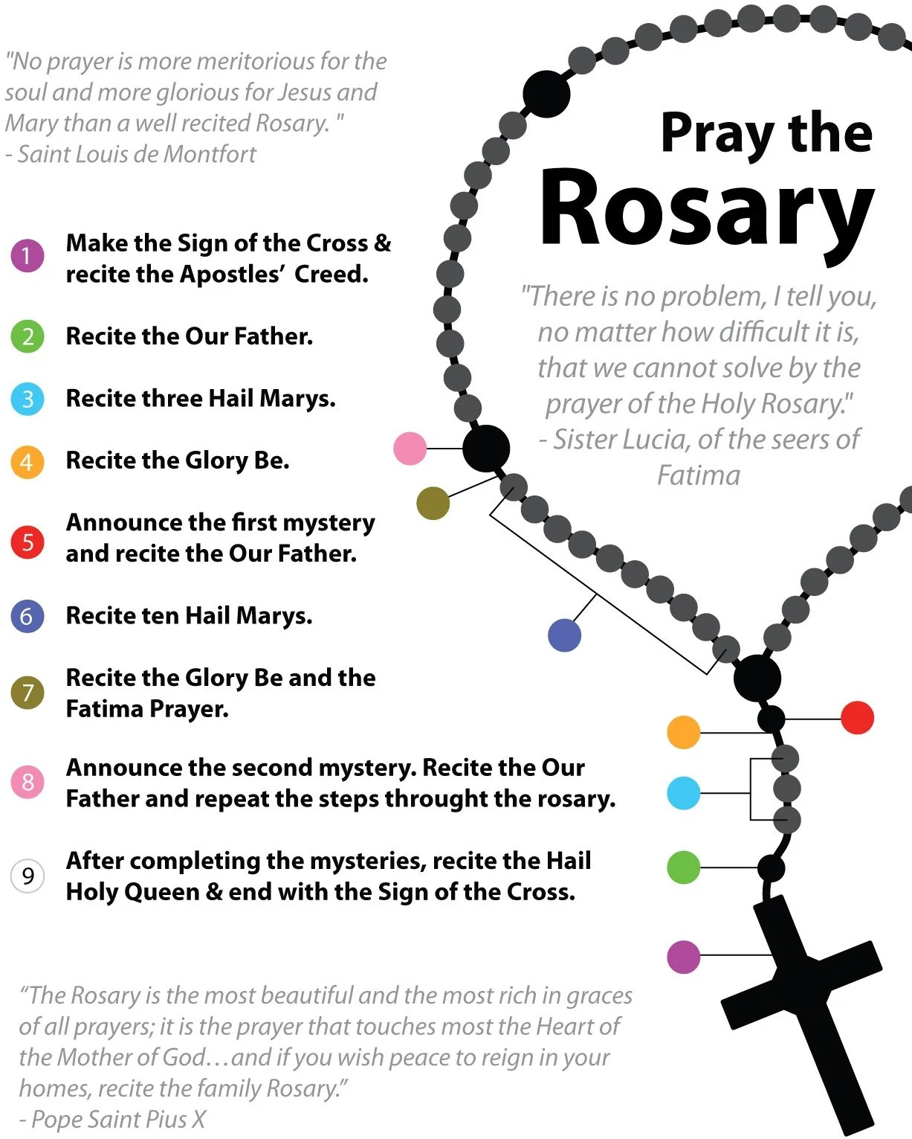
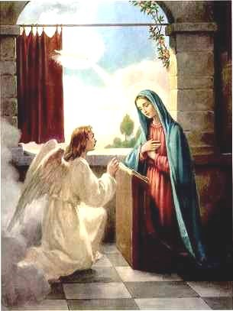
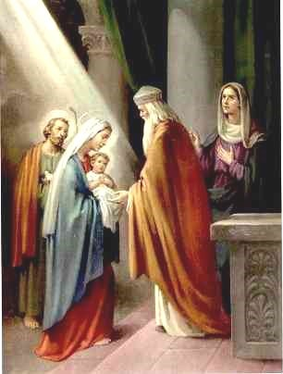
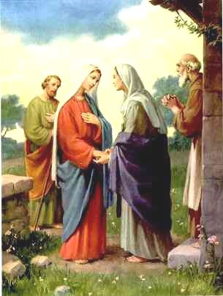
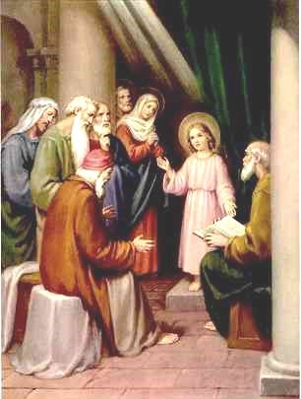
ROSARY MEDITATIONS
The Birth of Jesus
Mary was pregnant with Jesus, and Joseph was going to leave her because he did not want to shame her since they were not married. As Joseph slept, an angel appeared to him in a dream and said his child would be named Jesus. I imagine how scared Mary and Joseph were to find out she was pregnant. But after being visited by wise men and shepherds after Jesus’ birth, they were amazed at their words. I pray God helps me not to worry about little things and trust in His plan for me.
written by 7A Students of All Saints Catholic School
in October of 2026
Joyful Mysteries
Monday and Saturday
The Annunciation
The Angel Gabriel went and visited Mary and told her that she would have a son and name Him Jesus. A man named Joseph would be the foster father of Jesus. God chose Mary because she did not have original sin and was a faithful Jew. I imagine if I were Mary I would feel surprised that the angel Gabriel would come and visit me. I would pray to be a better person and help others also understanding things.
The Presentation of Jesus in the Temple
I believe one of the main fruits of the holy spirit in the Presentation of Jesus in the temple is faith. Even though Mary and Joseph knew their son was the messiah they were faithful to God and trusted that he had a plan. Simeon had faith when God told him he would meet the savior of the people before he died. I imagine this was hard because Israelites were praying for a savior for many years but Simeon had faith anyway. I pray God can give me the faith to trust him even when it is confusing and hard.
The Visitation
Jesus is found in the Temple
The Passover celebration has ended and Mary and Joseph return home. After a day, they realize Jesus is no longer with them and return to Jerusalem. For three days they searched and found Jesus in the temple relaxed and bothered to see his parents upset. I imagine this moment shows Jesus’ great knowledge, beyond those of the teachers. He even surprised the Rabbis. This demonstrates Jesus’ understanding of God and His will. Even though he has this knowledge he shows patience and obeys his parents. I pray for the ability to comprehend my faith and to trust God.
I imagine Mary walking up the path, probably her feet is sore for days from traveling, wondering if Elizabeth will understand the incredible thing that happened to her. But the moment she knocks on the door Elizabeth came running to her and hugging her with a mix of emotions. Right then, Elizabeth feels the baby jump on her womb because he was jumping for joy maybe because Jesus was near. I pray that i can show my family the same love and support.

Slide 2
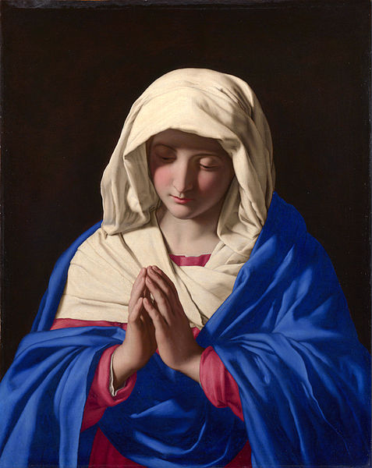
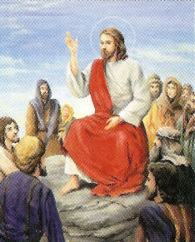
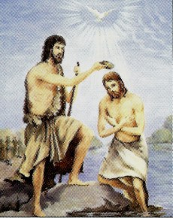
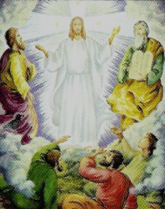
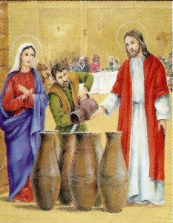
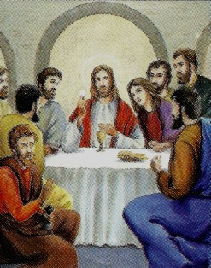
ROSARY MEDITATIONS
The Proclamation of the Kingdom
Jesus went out to all the lands in Galilee, proclaiming the Good News to all the people. Large crowds from Galilee follow Him. He gave them the Beatitudes. He tells them that they are the salt of the earth, then Jesus teaches them about the law. He tells them to follow these commandments He has given them. I imagine the people would have been inspired and wanted to hear more. I pray that I may have the strength to listen to God’s law, obey his commandments, and to avoid temptation to sin.
written by 7A Students of All Saints Catholic School
in October of 2025
Luminous Mysteries
Thursday
The Baptism of Jesus
The baptism of Jesus was an event when Jesus was baptized by John the Baptist in the Jordan River. Shortly after Jesus was baptized at the river, he was praying when Heaven was opened and the Holy Spirit descended upon him in bodily form like a dove. Then, a voice came from Heaven, it said, “You are my beloved Son; with you I am well pleased.” I imagine how Jesus felt clean and holy when heaven was opened for him. I pray that I can be like Jesus and live a Holy life like him and follow his ways forever.
The Transfiguration of Jesus
Jesus took three of his disciples, Peter, James, and John to a high mountain and Jesus’s clothes changed to white as light. And they see Moses and Elijah with Jesus. And Jesus tells them that he is going to set up tents for them. I imagine that Peter, James, and John are a little surprised and amazed to see Moses and Elijah. But grateful to be with Jesus. I pray that one day far from now or soon is that I can be with Jesus.
The Miracle at the Wedding of Cana
The Institution of the Holy Eucharist
Peter and John prepare for their last meal with Jesus, following the instructions given to them by Him. Jesus describes what will happen in his Last Supper, and he will not eat the bread till the fulfillment in the kingdom of God. He notifies the apostles one of them will betray him, and Peter will deny him. I imagine how terrified Jesus is for the suffering he is to go through the next day, all while caring for the needs of others who betrayed him. I pray for the strength, courage, and trust Jesus has.
Jesus turns water into wine in the wedding of Cana when they run out, it leaves people speechless. Jesus gives water to the head waiter to drink and when he drinks it turns into red wine. Jesus does this as the beginning of his signs. I imagine that everyone was stunned and believed Jesus had made a miracle happen right in front of them. I pray that Jesus and His Holy Spirit will help me be able to help other people and give to the needy who are in need of help.

Slide 3
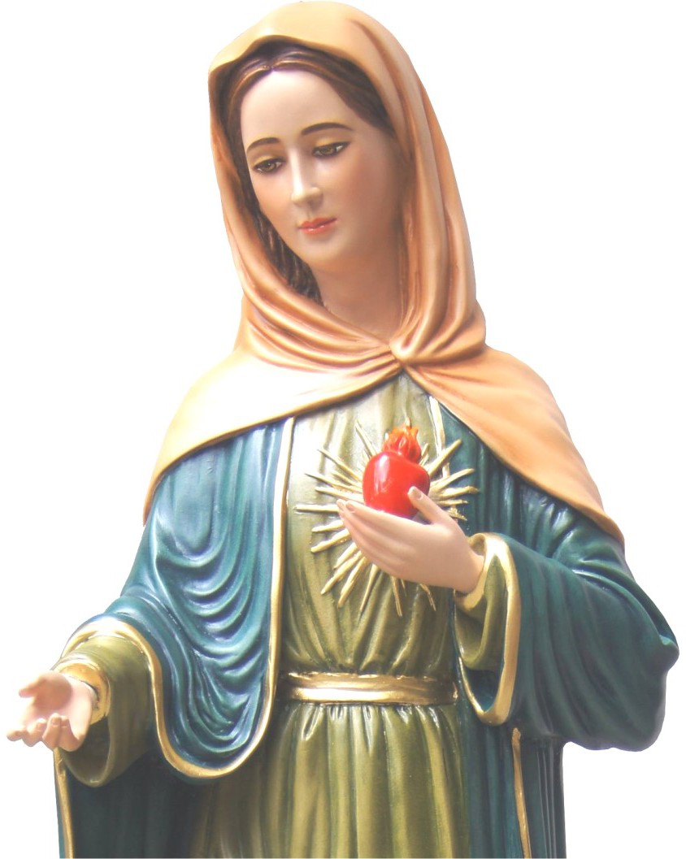
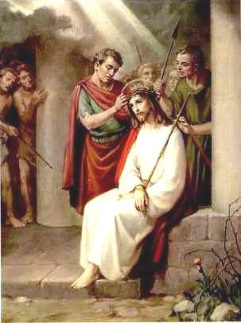
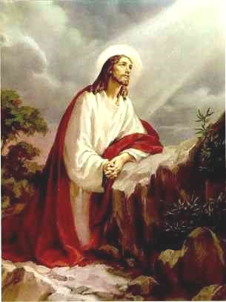
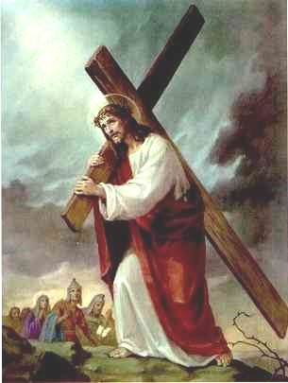
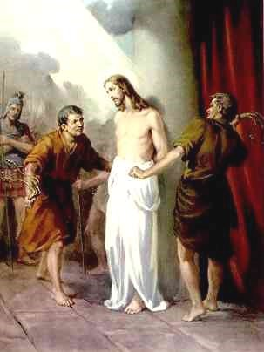
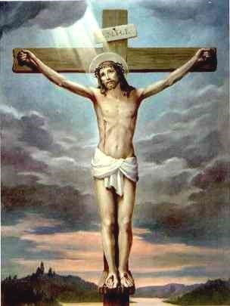
ROSARY MEDITATIONS
The Crowning of Thorns
Jesus, dressed in a purple cloak, is being mocked. “Hail, king of the Jews,” the guards say while beating him. Pilate says Jesus is innocent, but the chief priests and guards yell, “Crucify him!” Pilate still maintains that Jesus is innocent, but the people say he claims to be a king and is against Caesar. After hearing this, he commands Jesus to be crucified. I imagine the fear Pilate is feeling. He knows Jesus is good, but when he tries to save him, he gets threatened, so he crucifies Jesus. I pray that people are nicer and more forgiving.
written by 7A Students of All Saints Catholic School
in October of 2025
Sorrowful Mysteries
Tuesday and Friday
The Agony in the Garden
Jesus is praying in the garden of Gethsemane about his coming death with Peter, James, and John. So agonized, he begins sweating blood. The others fall asleep, so Jesus scolds them and tells them to pray, but they fall asleep again. I imagine how awful Jesus must have felt, knowing he was to die, and his friends couldn't even stay awake. I pray for patience like Jesus had at such a stressful moment, and the alertness to follow God even when it's difficult.
Jesus Carrying His Cross
Jesus is carrying his cross. He is clearly struggling from the heat of the sun, the weight of the cross, and the roar of the crowd. His eyes are filled with sorrow, his flesh is bleeding, and he is agonizing with pain and suffering. I imagine his weeping eyes, his broken expression, and his staggering wounds. I pray that whatever burden we may have in our modern life, that we may have the patience to handle it just like Jesus did when he was faced with the cross.
The Scourging at the Pillar
The Crucifixion and Death of Jesus
The soldiers took Jesus inside the praetorium and gathered a crowd of people. The soldiers put a scarlet cloak around him and placed a crown of thorns on his head. The people knelt before him, teasing and mocking him while saying “Hail King of the Jews!” Time stretched on as the crowd was waiting for Jesus’ death. I imagine Jesus hanging on the cross asking God to have mercy on us. The time had come, he finally died. I pray for patience and kindness to be able to tolerate other’s behaviors even when it annoys me.
In the morning, Jesus was sent to the Praetorian; it looks like a court room to me. I imagine how painful it was for Jesus to be scourged by Pilate’s soldiers since it was our sins that got him here. Jesus never stopped them. The people who were watching him getting whipped were sad and wishing that it would stop. I pray for strength to not sin since the scourging was painful and I do not want to hurt Jesus.

Slide 4
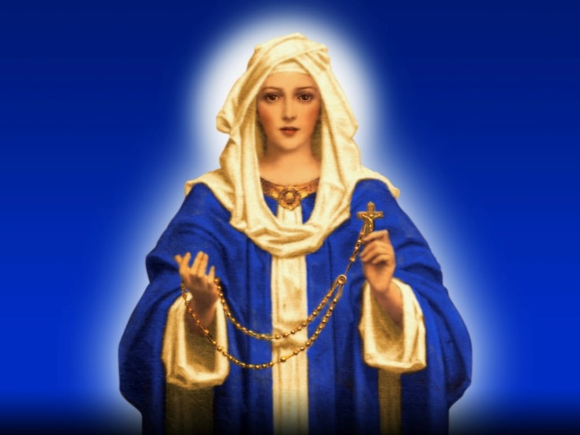
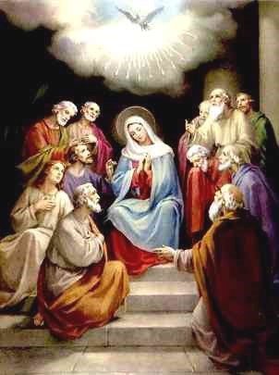
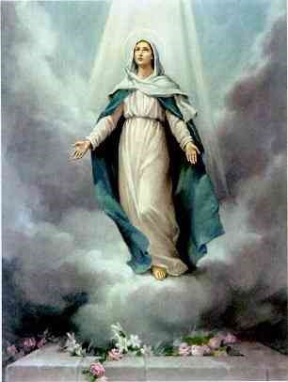
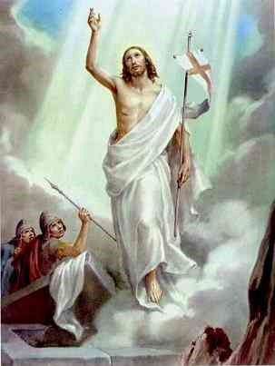
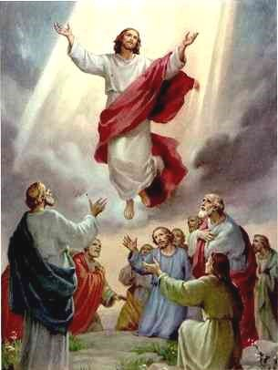
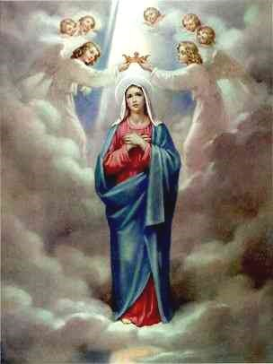
ROSARY MEDITATIONS
Descent of the Holy Spirit at Pentecost
The Jews felt a strong wind fill the house. They were filled with the Holy Spirit and began speaking in different languages. People were confused because everyone heard them speaking in their own language. Some people thought they had drunk too much wine, but then Peter stood up and gave a speech. He explained that whoever calls on the name of the Lord will be saved. I imagine the Holy Spirit gave the Jews courage. I pray that the Holy Spirit helps me be brave, trust God, and accept new experiences.
written by 7A Students of All Saints Catholic School
in October of 2025
Glorious Mysteries
Sunday and Wednesday
The Resurrection of Jesus
In the scripture Mary Magdalene finds Jesus’ tomb empty. Soon, Jesus appears and calls her name, showing He is alive. I imagine the amazing feeling of surprise and pure joy filling her heart when she sees Him. The sadness of His death disappears in the bright light of Easter day. I pray that God will help me be strong when I feel afraid. I also hope that the joy of the resurrection always guides me to share God’s peace, love, and happiness with everyone I see.
The Assumption of Mary into Heaven
The seventh angel blew his trumpet. Loud voices echoed saying “The kingdom of the world now belongs to our Lord and to his anointed, he will reign forever and ever” The elders who sat on thrones prostrated themselves and worshiped God. God's Temple was opened and the Ark could be seen. Flashes of lighting, earthquakes, and hailstorms were happening. I imagine hearing the trumpet and seeing flashes of lighting in the sky. I would probably feel amazed that everyone is worshiping God. I pray that God helps me trust him when things are confusing and helps me grow in faith
The Ascension of our Lord
The Coronation of Mary in Heaven
Mary is the Queen of Heaven and Earth and the mother of all of us. Satan wanted to kill the Son of God so that he could have power over the whole world. Satan came to Earth to destroy Mary, her child, and us all. I imagine Mary's emotions when she was visited by the angel Gabriel, and was told she would be the mother of Jesus. And after her Assumption she was crowned Queen of Heaven. I pray that we all model ourselves after Mary and Jesus in our everyday life.
Jesus gathers his disciples on the Mount of Olives, offering final blessings before ascending into the heavens until a radiant cloud cloaks Him from view. I imagine the profound awe and bittersweet wonder filling the disciples' hearts as they watched their Lord ascend, realizing His earthly mission was perfectly complete. I pray for the virtue of divine hope, asking God to keep my eyes fixed on eternity. May I always trust that Christ is preparing a permanent home for us while remaining spiritually present by our side.

Slide 5
THE ROSARY
APOSTLES CREED
I believe in God,
the Father almighty,
Creator of heaven and earth,
and in Jesus Christ, his only Son, our Lord,
who was conceived by the Holy Spirit,
born of the Virgin Mary,
suffered under Pontius Pilate,
was crucified, died and was buried;
he descended into hell;
on the third day he rose again from the dead;
he ascended into heaven,
and is seated at the right hand of God the Father almighty;
from there he will come to judge the living and the dead.
I believe in the Holy Spirit,
the holy catholic Church,
the communion of saints,
the forgiveness of sins,
the resurrection of the body,
and life everlasting.
Amen.

Slide 6
THE ROSARY
OUR FATHER
Our Father, who art in heaven,
hallowed be thy name;
thy kingdom come;
thy will be done on earth as it is in heaven.
Give us this day our daily bread;
and forgive us our trespasses
as we forgive those who trespass
against us;
and lead us not into temptation,
but deliver us from evil.
Amen
HAIL MARY (x3)
Hail Mary, full of grace, the Lord is with you;
blessed are you among women,
and blessed is the fruit of your womb, Jesus.
Holy Mary, Mother of God,
pray for us sinners
now and at the hour of our death.
Amen.
GLORY BE
Glory be to the Father, the Son, and the Holy Spirit;
as it was in the beginning, is now, and ever shall be,
world without end.
Amen.

Slide 7
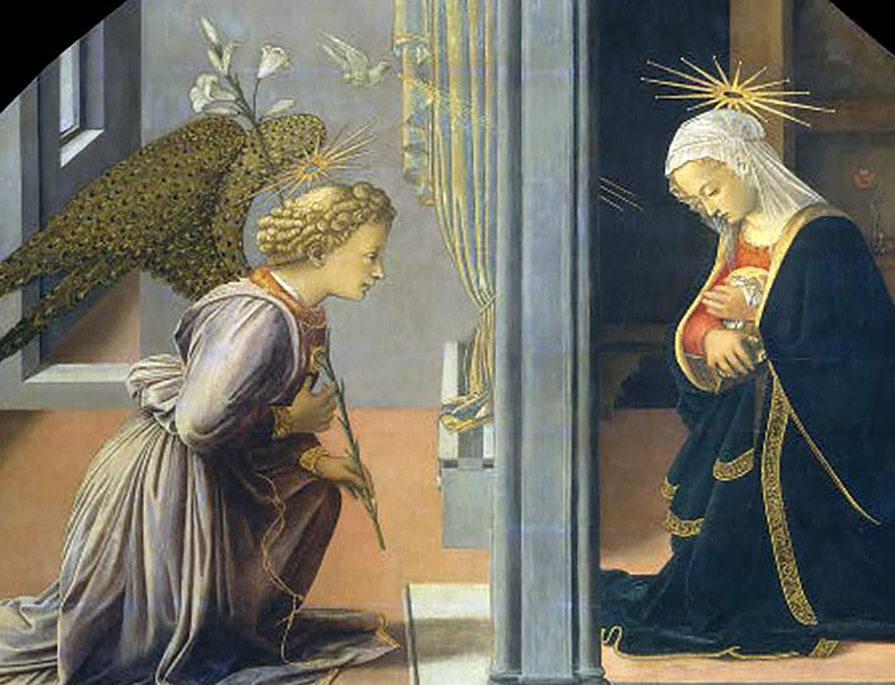
1st Joyful: ANNUNCIATION
The Angel Gabriel went and visited Mary and told her that she would have a son and name Him Jesus. A man named Joseph would be the foster father of Jesus. God chose Mary because she did not have original sin and was a faithful Jew. I imagine if I were Mary I would feel surprised that the angel Gabriel would come and visit me. I would pray to be a better person and help others also understanding things.

Slide 8
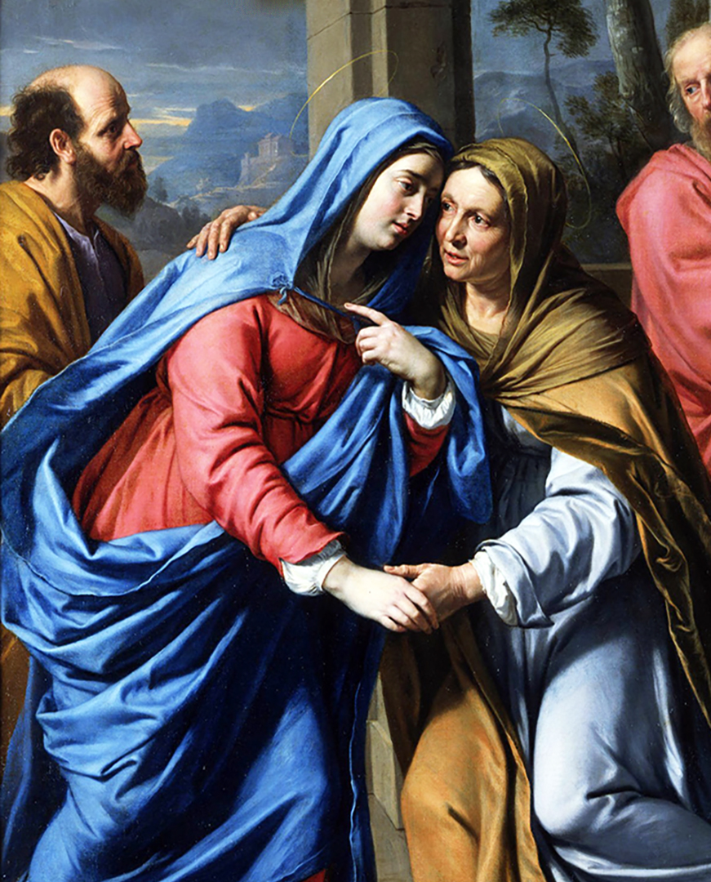
2nd Joyful: VISITATION
I imagine Mary walking up the path, probably her feet is sore for days from traveling, wondering if Elizabeth will understand the incredible thing that happened to her. But the moment she knocks on the door Elizabeth came running to her and hugging her with a mix of emotions. Right then, Elizabeth feels the baby jump on her womb because he was jumping for joy maybe because Jesus was near. I pray that i can show my family the same love and support.

Slide 9
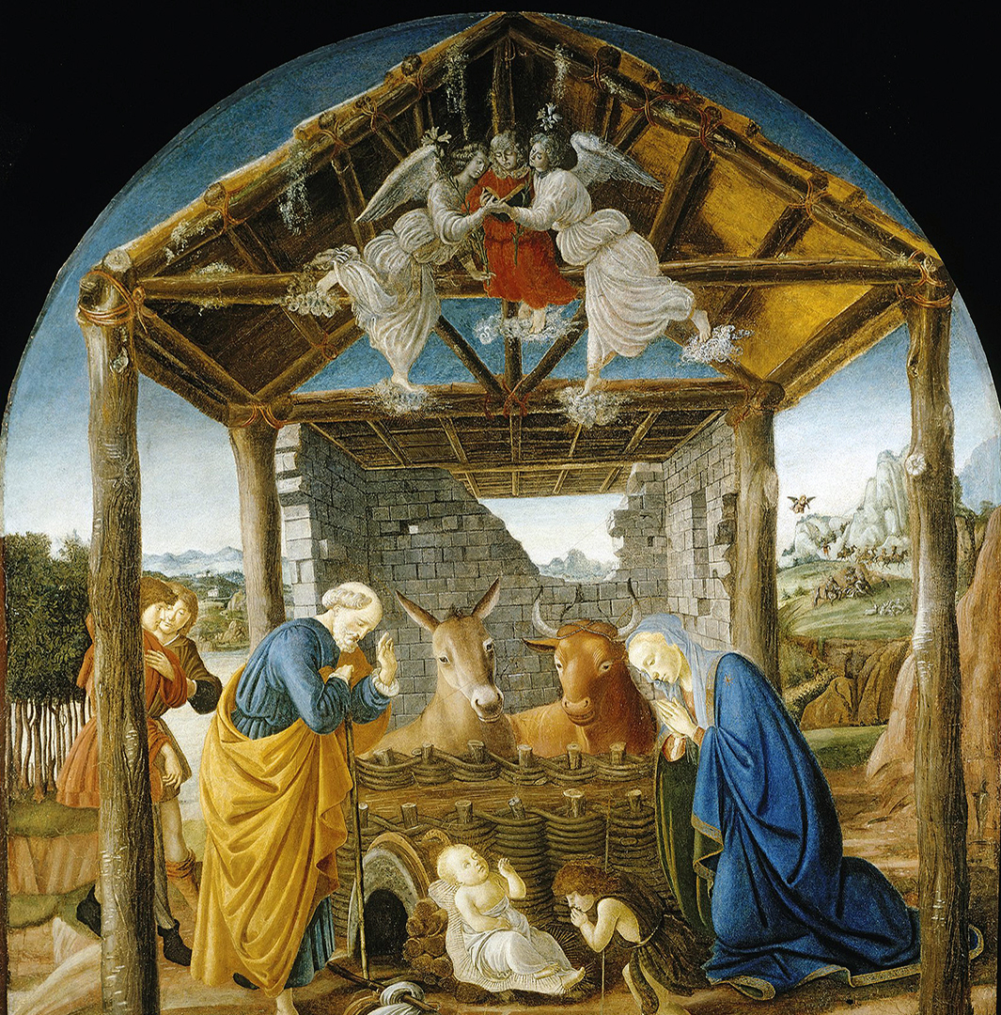
3rd Joyful: BIRTH OF JESUS
Mary was pregnant with Jesus, and Joseph was going to leave her because he did not want to shame her since they were not married. As Joseph slept, an angel appeared to him in a dream and said his child would be named Jesus. I imagine how scared Mary and Joseph were to find out she was pregnant. But after being visited by wise men and shepherds after Jesus’ birth, they were amazed at their words. I pray God helps me not to worry about little things and trust in His plan for me.

Slide 10
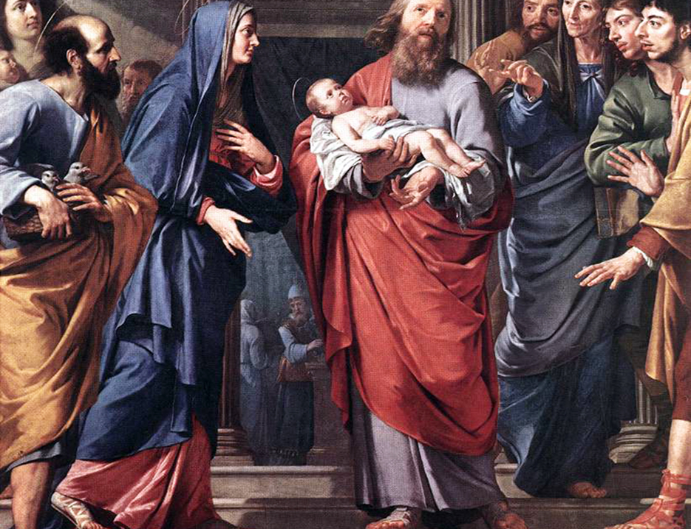
4th Joyful: PRESENTATION OF JESUS AT TEMPLE
I believe one of the main fruits of the holy spirit in the Presentation of Jesus in the temple is faith. Even though Mary and Joseph knew their son was the messiah they were faithful to God and trusted that he had a plan. Simeon had faith when God told him he would meet the savior of the people before he died. I imagine this was hard because Israelites were praying for a savior for many years but Simeon had faith anyway. I pray God can give me the faith to trust him even when it is confusing and hard.

Slide 11
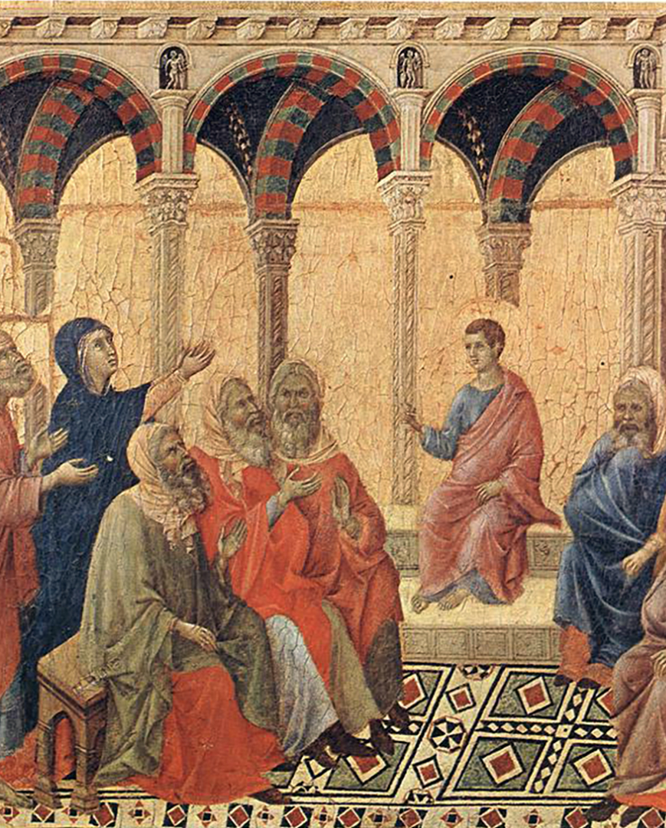
5th Joyful: JESUS IS FOUND IN THE TEMPLE
The Passover celebration has ended and Mary and Joseph return home. After a day, they realize Jesus is no longer with them and return to Jerusalem. For three days they searched and found Jesus in the temple relaxed and bothered to see his parents upset. I imagine this moment shows Jesus’ great knowledge, beyond those of the teachers. He even surprised the Rabbis. This demonstrates Jesus’ understanding of God and His will. Even though he has this knowledge he shows patience and obeys his parents. I pray for the ability to comprehend my faith and to trust God.

Slide 12
THE ROSARY
GLORY BE
Glory be to the Father, the Son, and the Holy Spirit;
as it was in the beginning, is now, and ever shall be,
world without end.
Amen.
FATIMA PRAYER
O my Jesus, forgive us our sins, save us from the fires of hell, and lead all souls to heaven, especially those most in need of Thy mercy.
OUR FATHER…

Slide 13
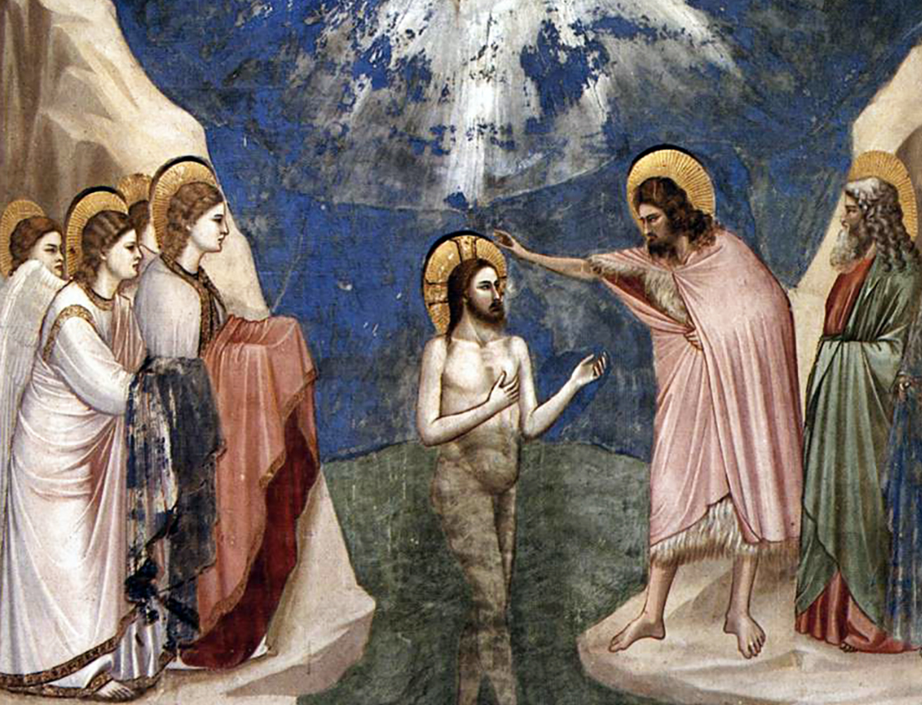
1st Luminous: BAPTISM OF JESUS
The baptism of Jesus was an event when Jesus was baptized by John the Baptist in the Jordan River. Shortly after Jesus was baptized at the river, he was praying when Heaven was opened and the Holy Spirit descended upon him in bodily form like a dove. Then, a voice came from Heaven, it said, “You are my beloved Son; with you I am well pleased.” I imagine how Jesus felt clean and holy when heaven was opened for him. I pray that I can be like Jesus and live a Holy life like him and follow his ways forever.

Slide 14
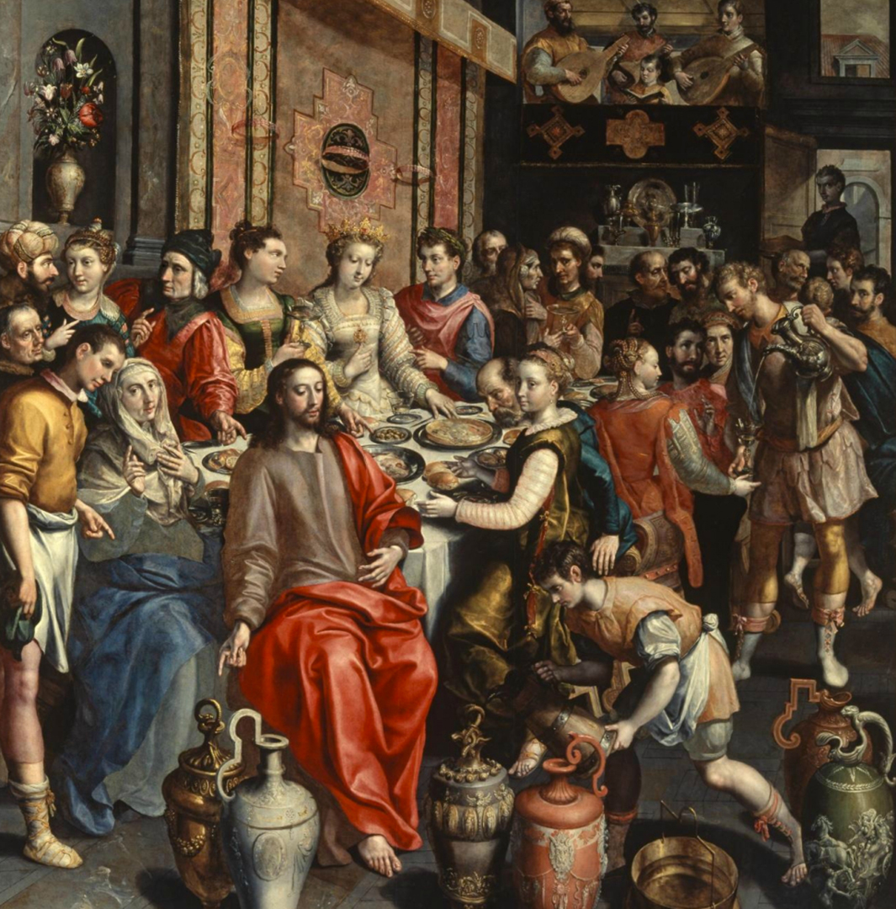
2nd Luminous: MIRACLE AT WEDDING OF CANA
Jesus turns water into wine in the wedding of Cana when they run out, it leaves people speechless. Jesus gives water to the head waiter to drink and when he drinks it turns into red wine. Jesus does this as the beginning of his signs. I imagine that everyone was stunned and believed Jesus had made a miracle happen right in front of them. I pray that Jesus and His Holy Spirit will help me be able to help other people and give to the needy who are in need of help.

Slide 15
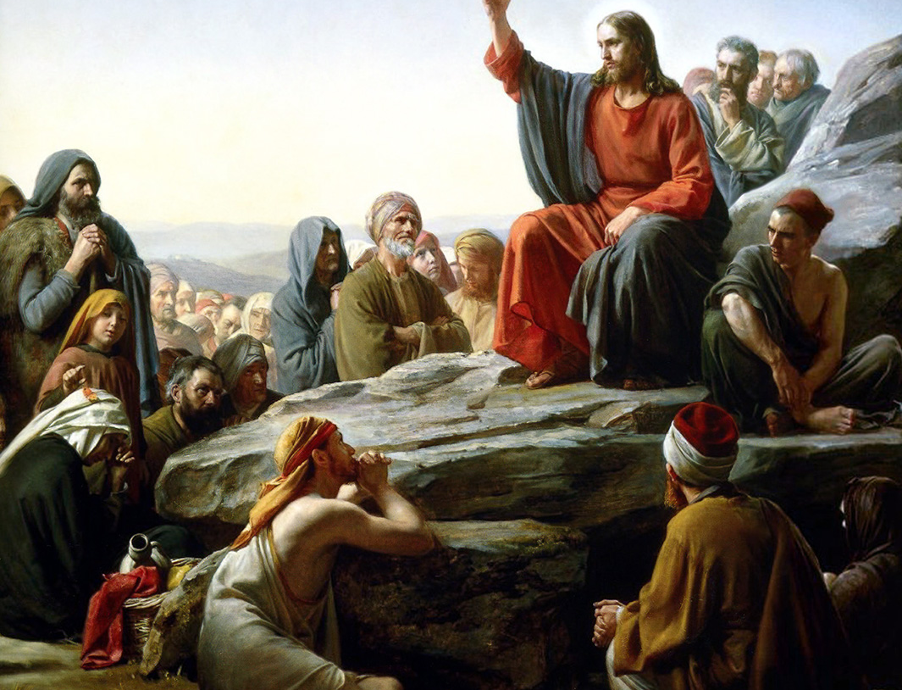
3rd Luminous: PROCLAMATION OF THE KINGDOM
Jesus went out to all the lands in Galilee, proclaiming the Good News to all the people. Large crowds from Galilee follow Him. He gave them the Beatitudes. He tells them that they are the salt of the earth, then Jesus teaches them about the law. He tells them to follow these commandments He has given them. I imagine the people would have been inspired and wanted to hear more. I pray that I may have the strength to listen to God’s law, obey his commandments, and to avoid temptation to sin.

Slide 16
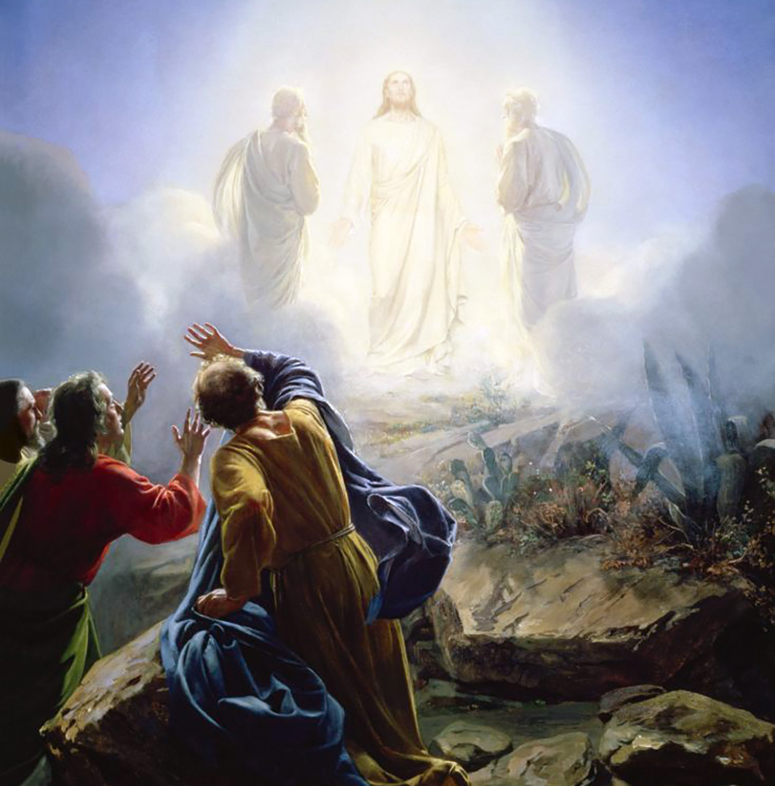
4th Luminous:
THE TRANSFIGURATION
Jesus took three of his disciples, Peter, James, and John to a high mountain and Jesus’s clothes changed to white as light. And they see Moses and Elijah with Jesus. And Jesus tells them that he is going to set up tents for them. I imagine that Peter, James, and John are a little surprised and amazed to see Moses and Elijah. But grateful to be with Jesus. I pray that one day far from now or soon is that I can be with Jesus.

Slide 17
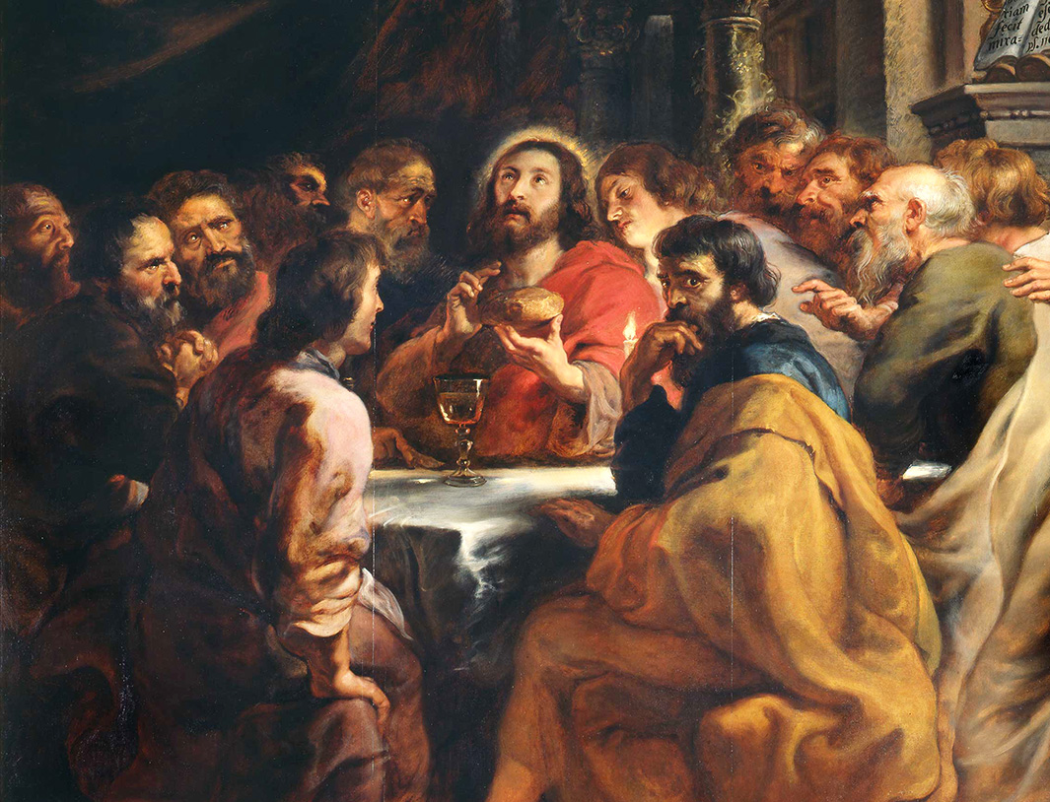
5th Luminous: INSTITUTION OF THE EUCHARIST
Peter and John prepare for their last meal with Jesus, following the instructions given to them by Him. Jesus describes what will happen in his Last Supper, and he will not eat the bread till the fulfillment in the kingdom of God. He notifies the apostles one of them will betray him, and Peter will deny him. I imagine how terrified Jesus is for the suffering he is to go through the next day, all while caring for the needs of others who betrayed him. I pray for the strength, courage, and trust Jesus has.

Slide 18
THE ROSARY
GLORY BE
Glory be to the Father, the Son, and the Holy Spirit;
as it was in the beginning, is now, and ever shall be,
world without end.
Amen.
FATIMA PRAYER
O my Jesus, forgive us our sins, save us from the fires of hell, and lead all souls to heaven, especially those most in need of Thy mercy.
OUR FATHER…

Slide 19
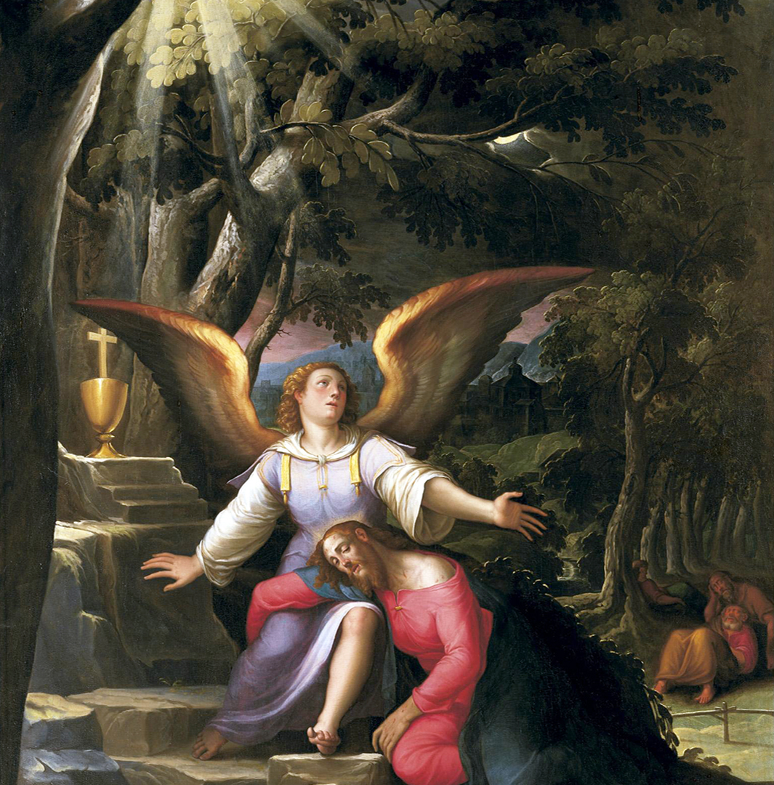
1st Sorrowful: AGONY IN
THE GARDEN
Jesus is praying in the garden of Gethsemane about his coming death with Peter, James, and John. So agonized, he begins sweating blood. The others fall asleep, so Jesus scolds them and tells them to pray, but they fall asleep again. I imagine how awful Jesus must have felt, knowing he was to die, and his friends couldn't even stay awake. I pray for patience like Jesus had at such a stressful moment, and the alertness to follow God even when it's difficult.

Slide 20
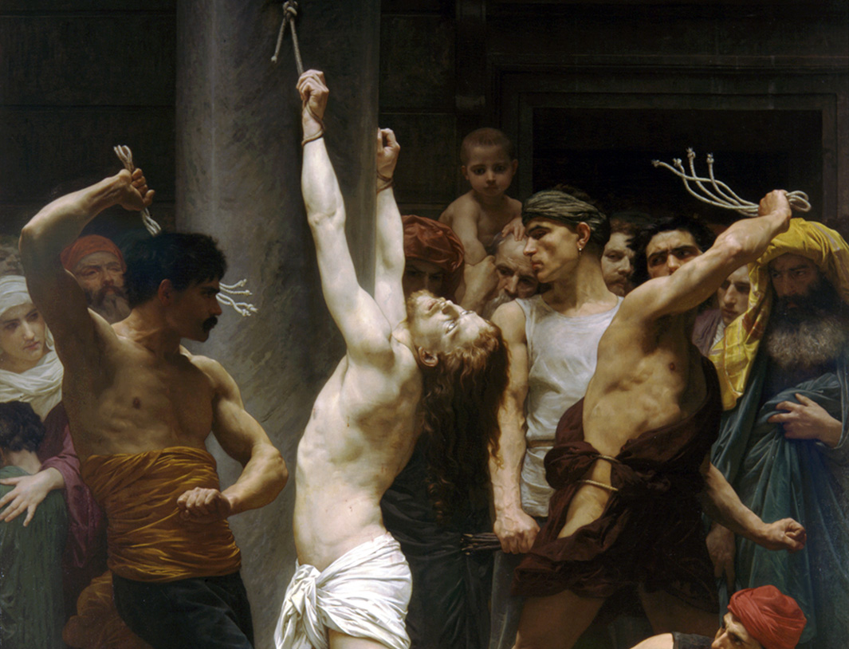
2nd Sorrowful: SCOURGING AT THE PILLAR
In the morning, Jesus was sent to the Praetorian; it looks like a court room to me. I imagine how painful it was for Jesus to be scourged by Pilate’s soldiers since it was our sins that got him here. Jesus never stopped them. The people who were watching him getting whipped were sad and wishing that it would stop. I pray for strength to not sin since the scourging was painful and I do not want to hurt Jesus.

Slide 21
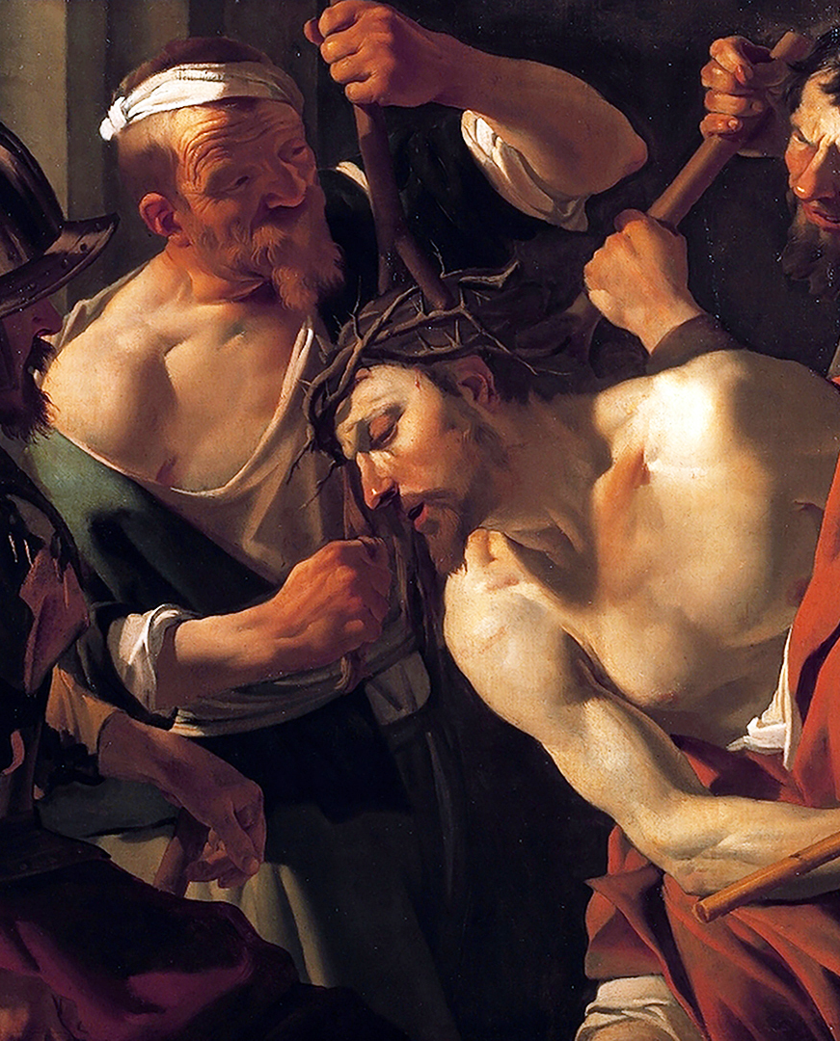
3rd Sorrowful: CROWNING OF THORNS
Jesus, dressed in a purple cloak, is being mocked. “Hail, king of the Jews,” the guards say while beating him. Pilate says Jesus is innocent, but the chief priests and guards yell, “Crucify him!” Pilate still maintains that Jesus is innocent, but the people say he claims to be a king and is against Caesar. After hearing this, he commands Jesus to be crucified. I imagine the fear Pilate is feeling. He knows Jesus is good, but when he tries to save him, he gets threatened, so he crucifies Jesus. I pray that people are nicer and more forgiving.

Slide 22
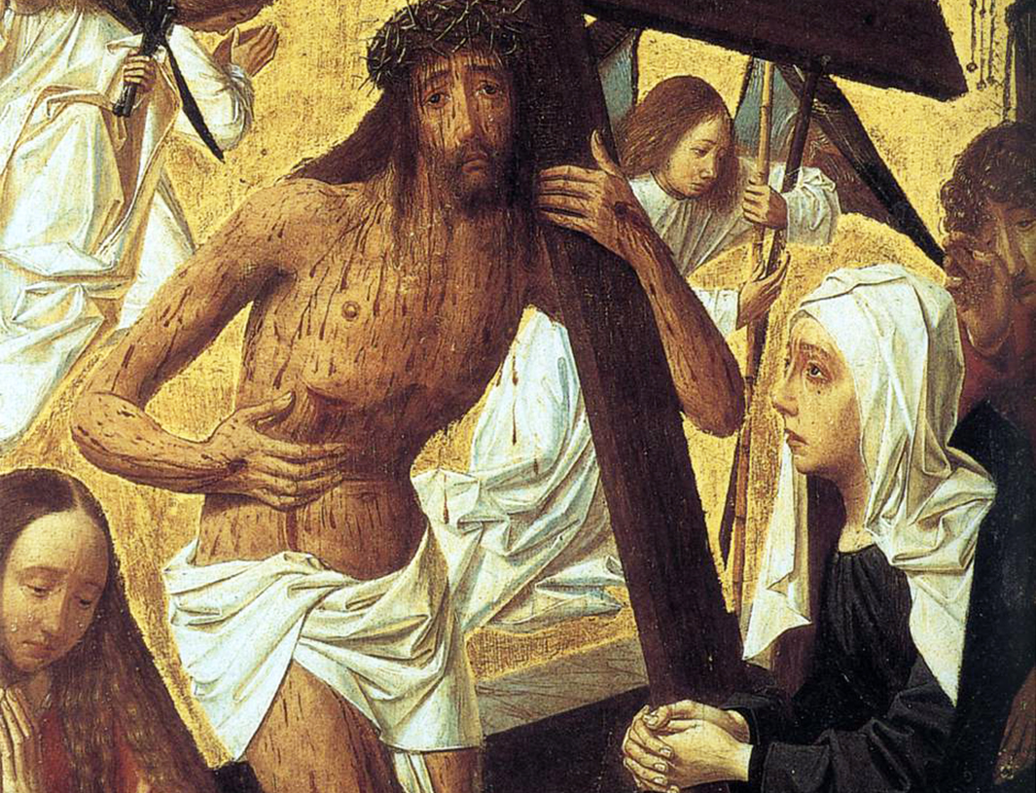
4th Sorrowful: JESUS CARRIES HIS CROSS
Jesus is carrying his cross. He is clearly struggling from the heat of the sun, the weight of the cross, and the roar of the crowd. His eyes are filled with sorrow, his flesh is bleeding, and he is agonizing with pain and suffering. I imagine his weeping eyes, his broken expression, and his staggering wounds. I pray that whatever burden we may have in our modern life, that we may have the patience to handle it just like Jesus did when he was faced with the cross.

Slide 23
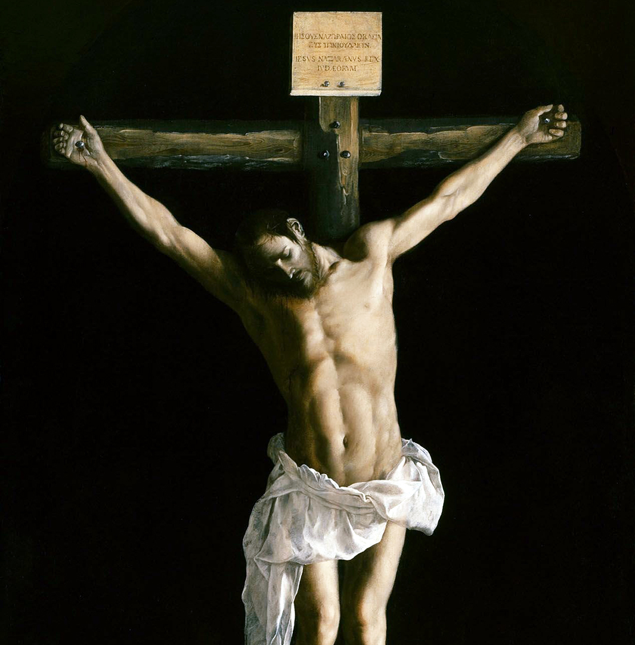
5th Sorrowful: CRUCIFIXION AND DEATH OF JESUS
The soldiers took Jesus inside the praetorium and gathered a crowd of people. The soldiers put a scarlet cloak around him and placed a crown of thorns on his head. The people knelt before him, teasing and mocking him while saying “Hail King of the Jews!” Time stretched on as the crowd was waiting for Jesus’ death. I imagine Jesus hanging on the cross asking God to have mercy on us. The time had come, he finally died. I pray for patience and kindness to be able to tolerate other’s behaviors even when it annoys me.

Slide 24
THE ROSARY
GLORY BE
Glory be to the Father, the Son, and the Holy Spirit;
as it was in the beginning, is now, and ever shall be,
world without end.
Amen.
FATIMA PRAYER
O my Jesus, forgive us our sins, save us from the fires of hell, and lead all souls to heaven, especially those most in need of Thy mercy.
OUR FATHER…

Slide 25
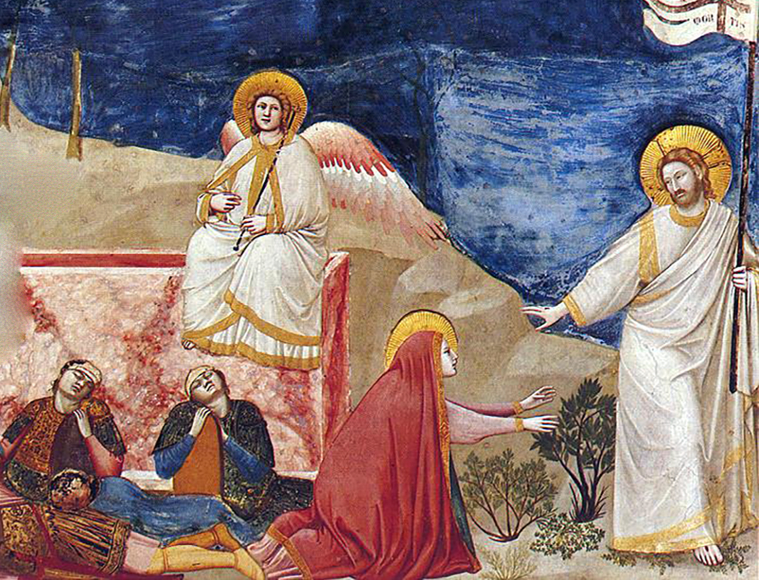
1st Glorious: RESURRECTION OF JESUS
In the scripture Mary Magdalene finds Jesus’ tomb empty. Soon, Jesus appears and calls her name, showing He is alive. I imagine the amazing feeling of surprise and pure joy filling her heart when she sees Him. The sadness of His death disappears in the bright light of Easter day. I pray that God will help me be strong when I feel afraid. I also hope that the joy of the resurrection always guides me to share God’s peace, love, and happiness with everyone I see.

Slide 26
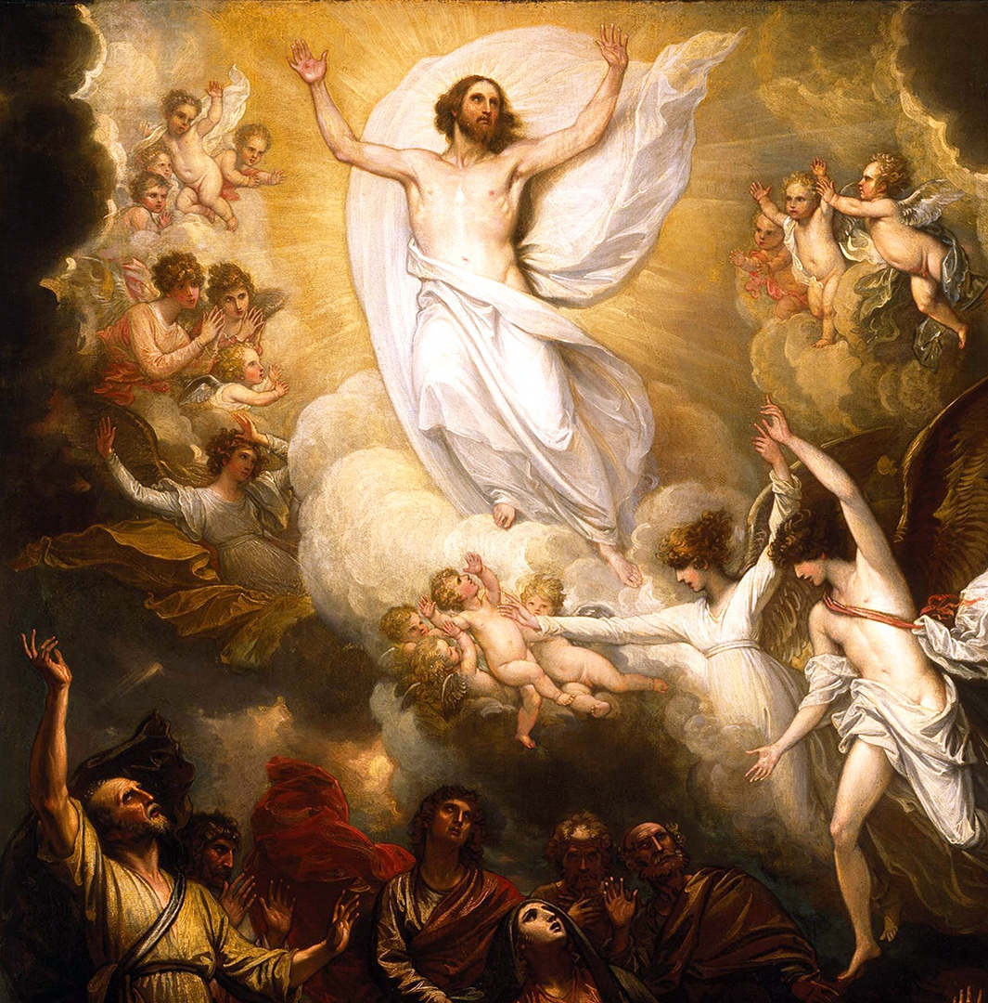
2nd Glorious: ASCENSION OF JESUS
Jesus gathers his disciples on the Mount of Olives, offering final blessings before ascending into the heavens until a radiant cloud cloaks Him from view. I imagine the profound awe and bittersweet wonder filling the disciples' hearts as they watched their Lord ascend, realizing His earthly mission was perfectly complete. I pray for the virtue of divine hope, asking God to keep my eyes fixed on eternity. May I always trust that Christ is preparing a permanent home for us while remaining spiritually present by our side.

Slide 27
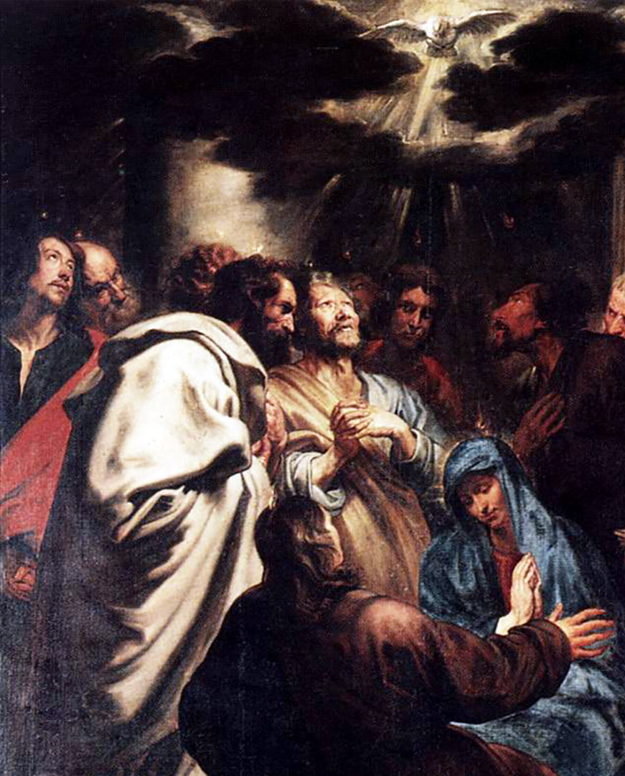
3rd Glorious: DESCENT OF THE HOLY SPIRIT
The Jews felt a strong wind fill the house. They were filled with the Holy Spirit and began speaking in different languages. People were confused because everyone heard them speaking in their own language. Some people thought they had drunk too much wine, but then Peter stood up and gave a speech. He explained that whoever calls on the name of the Lord will be saved. I imagine the Holy Spirit gave the Jews courage. I pray that the Holy Spirit helps me be brave, trust God, and accept new experiences.

Slide 28
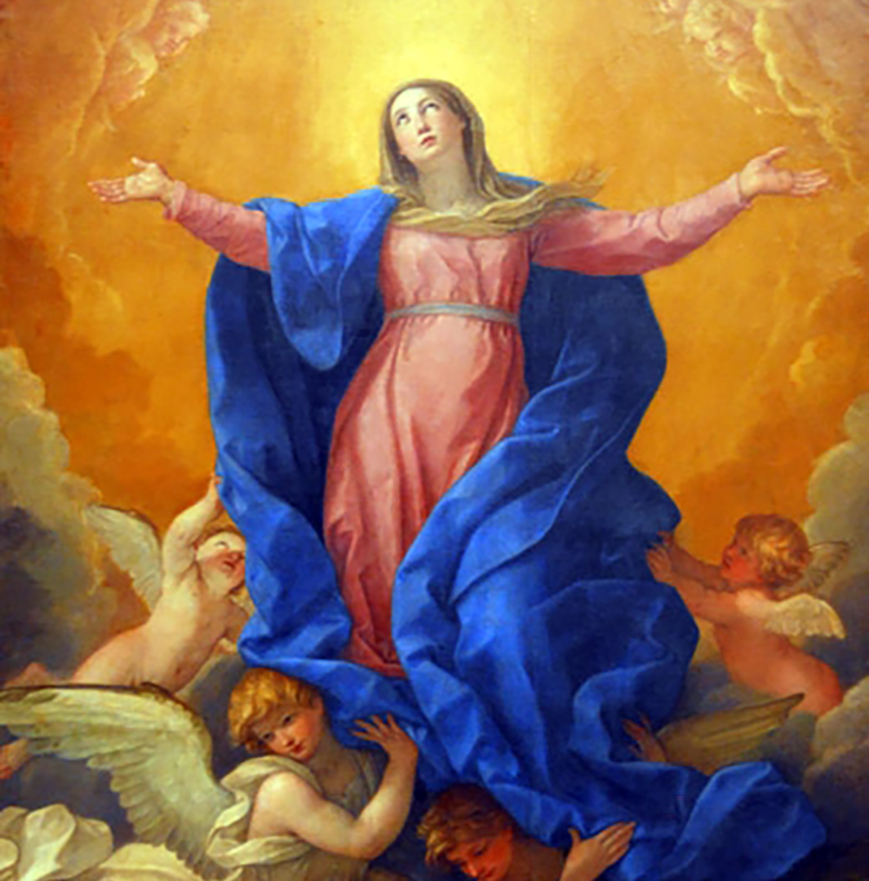
4th Glorious: ASSUMPTION OF MARY
The seventh angel blew his trumpet. Loud voices echoed saying “The kingdom of the world now belongs to our Lord and to his anointed, he will reign forever and ever” The elders who sat on thrones prostrated themselves and worshiped God. God's Temple was opened and the Ark could be seen. Flashes of lighting, earthquakes, and hailstorms were happening. I imagine hearing the trumpet and seeing flashes of lighting in the sky. I would probably feel amazed that everyone is worshiping God. I pray that God helps me trust him when things are confusing and helps me grow in faith

Slide 29
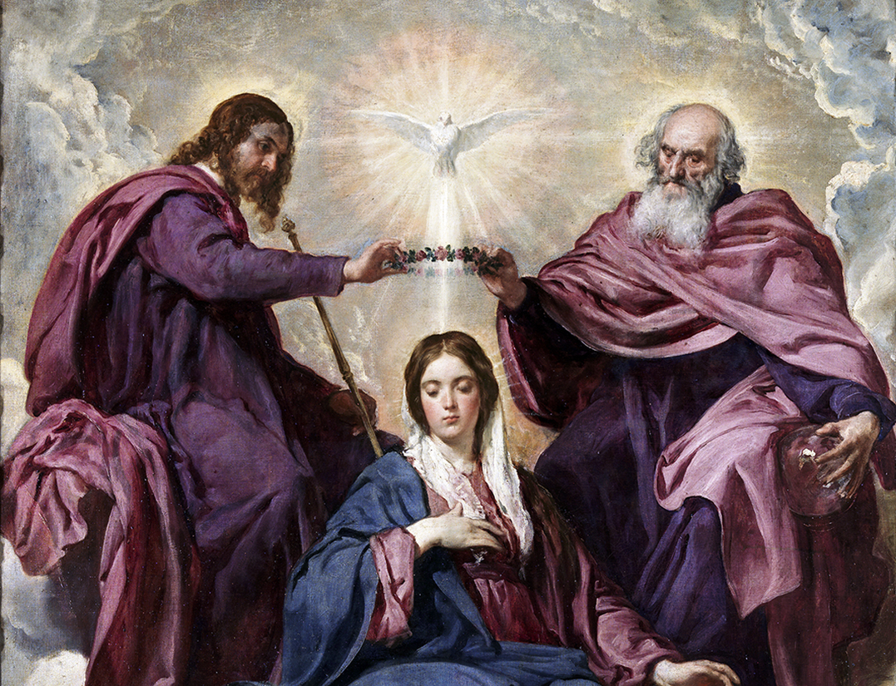
5th Glorious: CORONATION OF MARY
Mary is the Queen of Heaven and Earth and the mother of all of us. Satan wanted to kill the Son of God so that he could have power over the whole world. Satan came to Earth to destroy Mary, her child, and us all. I imagine Mary's emotions when she was visited by the angel Gabriel, and was told she would be the mother of Jesus. And after her Assumption she was crowned Queen of Heaven. I pray that we all model ourselves after Mary and Jesus in our everyday life.

Slide 30
THE ROSARY
GLORY BE
Glory be to the Father, the Son, and the Holy Spirit;
as it was in the beginning, is now, and ever shall be,
world without end.
Amen.
FATIMA PRAYER
O my Jesus, forgive us our sins, save us from the fires of hell, and lead all souls to heaven, especially those most in need of Thy mercy.

Slide 31
THE ROSARY
HAIL HOLY QUEEN
Hail, holy Queen, mother of mercy,
our life, our sweetness, and our hope.
To you we cry, poor banished children of Eve;
to you we send up our sighs,
mourning and weeping in this valley of tears.
Turn, then, most gracious advocate,
your eyes of mercy toward us;
and after this, our exile,
show unto us the blessed fruit of your womb, Jesus.
O clement, O loving, O sweet Virgin Mary.

